Slide 1
UNIT 1
YOU AND
ME
你和我

Slide 2
We have different skin,
And different names.
But deep inside,
Are we the same?

Slide 3
Lesson 1 Different or the Same?
different (不同的)
same (相同的)

Slide 4
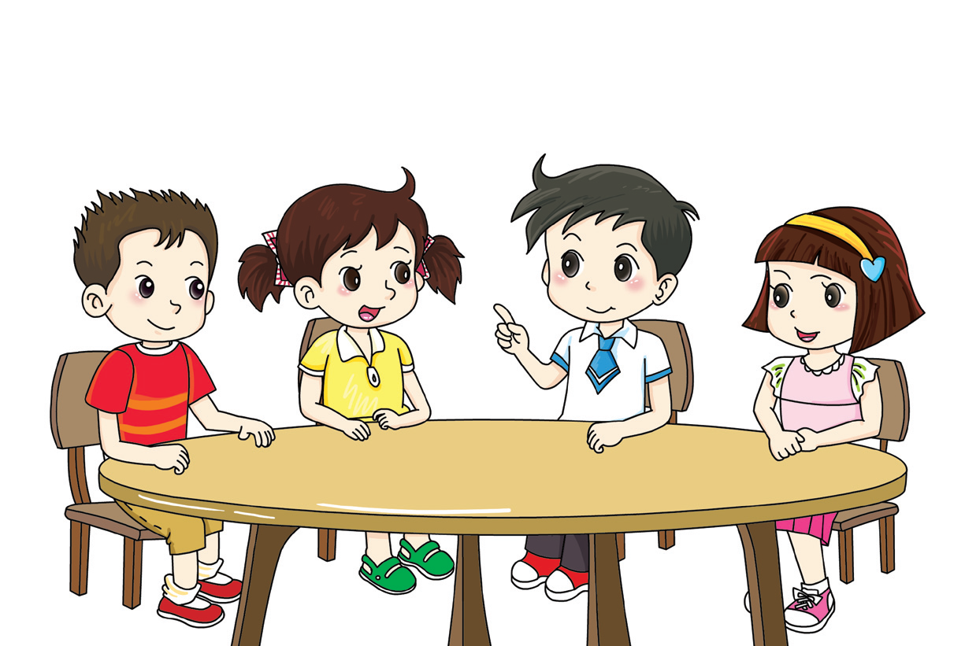
Are we all the same?
How are we the same?
We all have eyes.

Slide 5
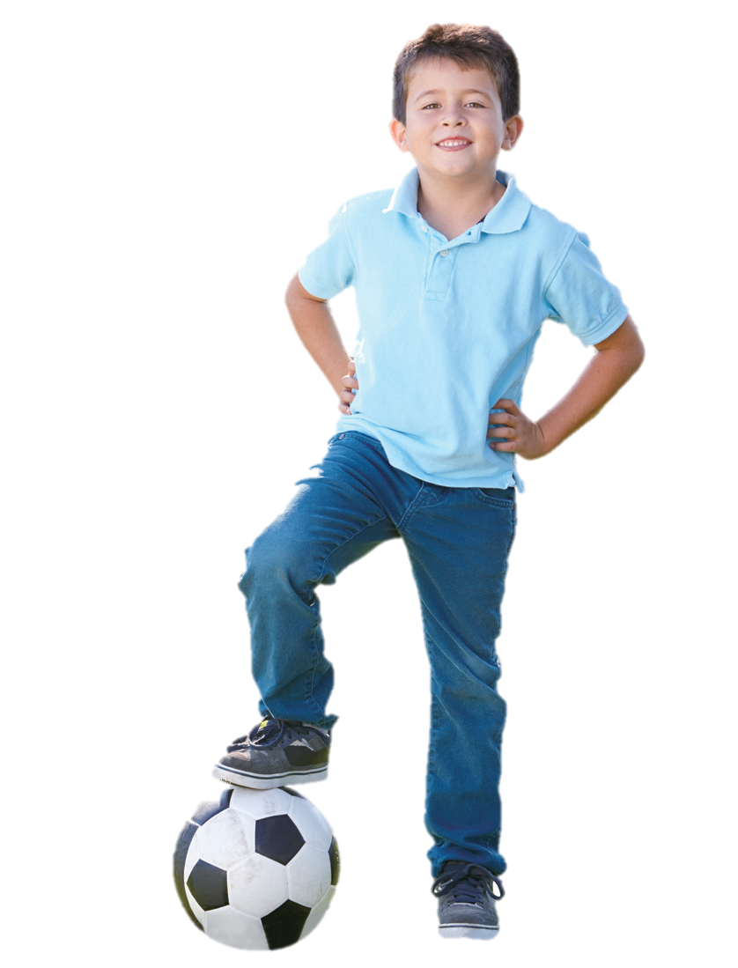
What body parts do you have? Tick(√).
√
hair
√
ear
√
eye
√
tooth
√
nose
√
neck
mouth
√
√
arm
hand
√
√
leg
foot
√

Slide 6
How are you and your friends the same? Tick (√) or cross (×).
Look at your … | Are you the same?
Hair colour
Eye colour
Skin colour
Nose shape
Shoe size

Slide 7
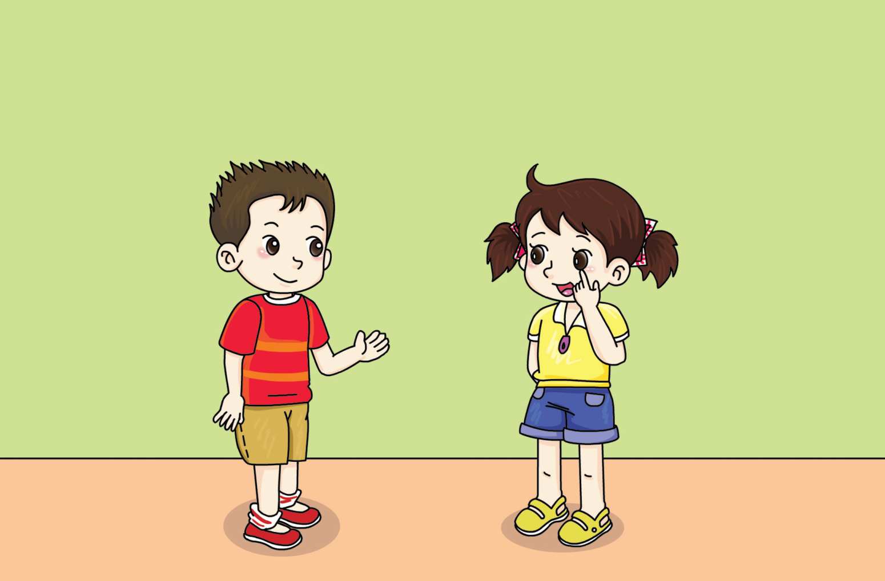
We all have dark eyes.

Slide 8
Match the children to their parents. Draw lines.

Slide 9
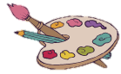
Draw pictures of your parents and yourself. How are you and your parents the same?
This is me.
My name is _________.
These are my parents.

Slide 10
In many ways I am the same as other children.
Children often look like their parents.

Slide 11
√
I compared other children with me.
√
I compared children and their parents.
I did an experiment.

Slide 12
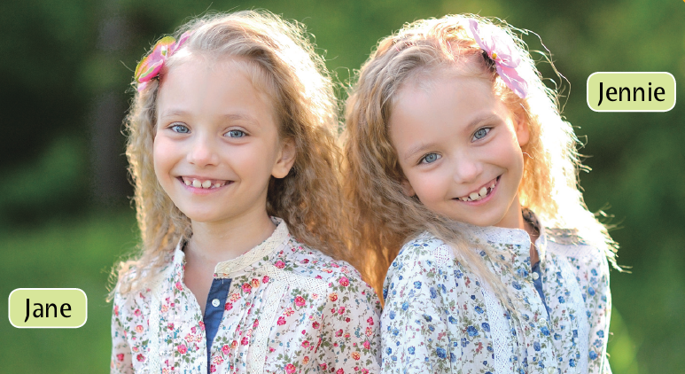
They are twins. How are they the same? Tick (√).
√
Eye colour
Shirt colour
√
Hair colour
√
Nose shape

Slide 13
Workbook

Slide 14
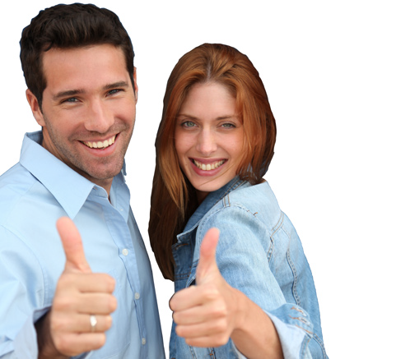
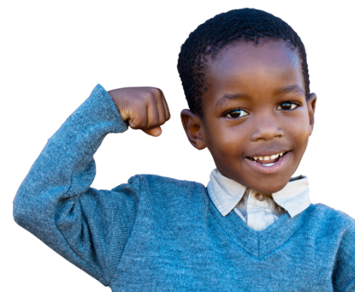
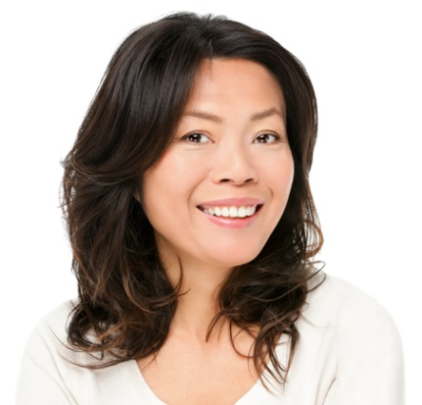
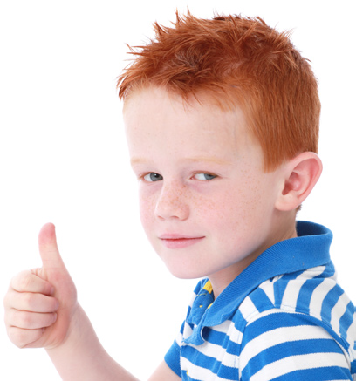
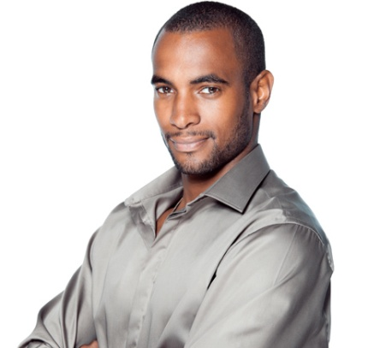
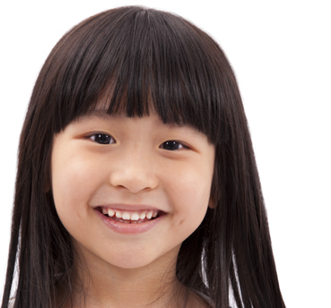
Match the children to their parents. Draw lines.

