Slide 1
UNIT 1
YOU AND
ME
你和我

Slide 2
Lesson 2 Growth and Change
grow (生长)
height (身高)
measure (测量)

Slide 3
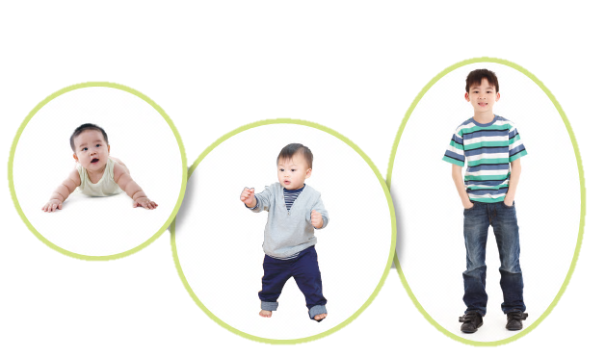
How do you change as you grow?

Slide 4
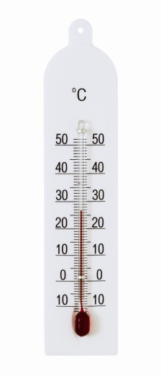
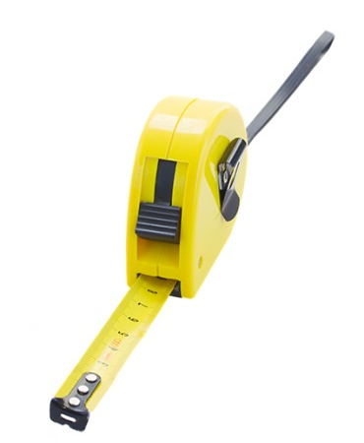
How can you measure your height? Circle the right instrument.
thermometer
clock
tape measure

Slide 5
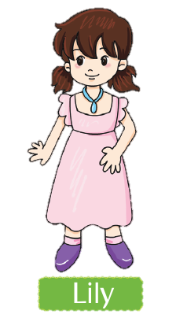
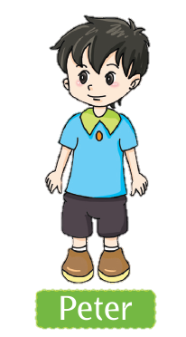
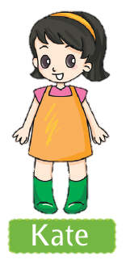
Peter is 120 cm tall. How tall are Lily and Kate? Circle the answers.
120 cm
110 cm or 130 cm
110 cm or 130 cm

Slide 6
Look at the chart. How does Bob’s height change?
7
How old was Bob when he was 125 cm tall? _____ years old.
130
How tall was Bob when he was 8 years old? _____ cm.
How tall will Bob be one year from now? why?
140 cm. Because he grew 5 cm each year between age 6 and 9.

Slide 7
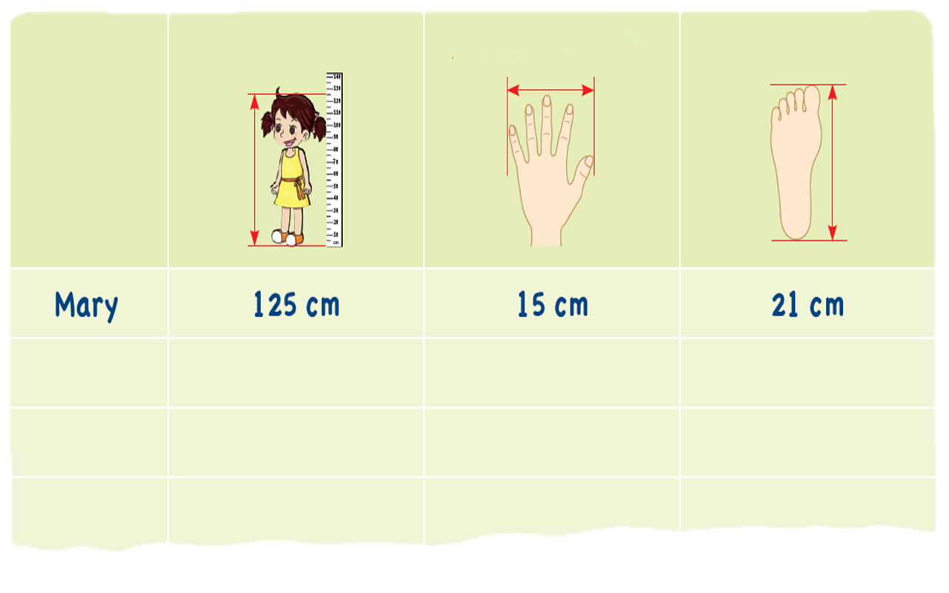
Take some measurements. Write the results.
Height
Hand span
Foot length
Name

Slide 8
What about next year? What do you think?

Slide 9
We grow. We get bigger.
We can measure our changes.

Slide 10
√
I took some measurements.
√
I inferred from the chart.
I used a clock.

Slide 11
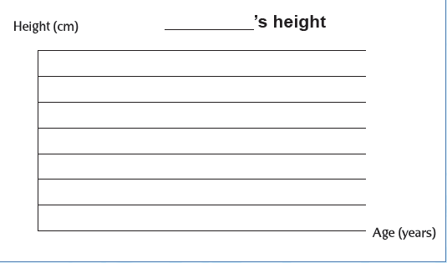
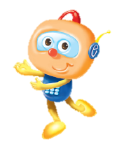
How does your height change? Think and make a chart.

Slide 12
Workbook

Slide 13
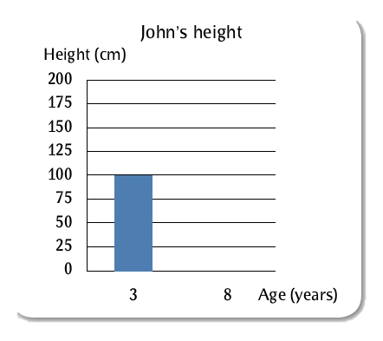
How do they grow? Draw the charts.
John, 3 years old.
Height: 100 cm
John, 8 years old.
Height: 125 cm

Slide 14
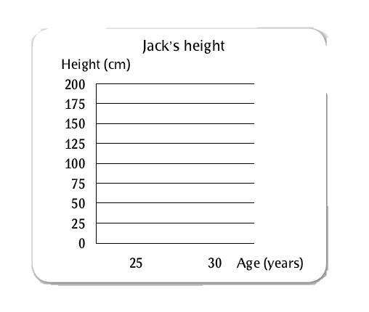
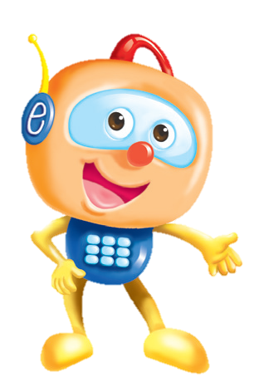
Jack, 25 years old.
Height: 175 cm
Jack, 30 years old.
Height: 175 cm
Do adults grow like children do?

