Slide 1
UNIT 1
YOU AND
ME
你和我

Slide 2
Lesson 3 People in the World
different (不同的)
same (相同的)

Slide 3
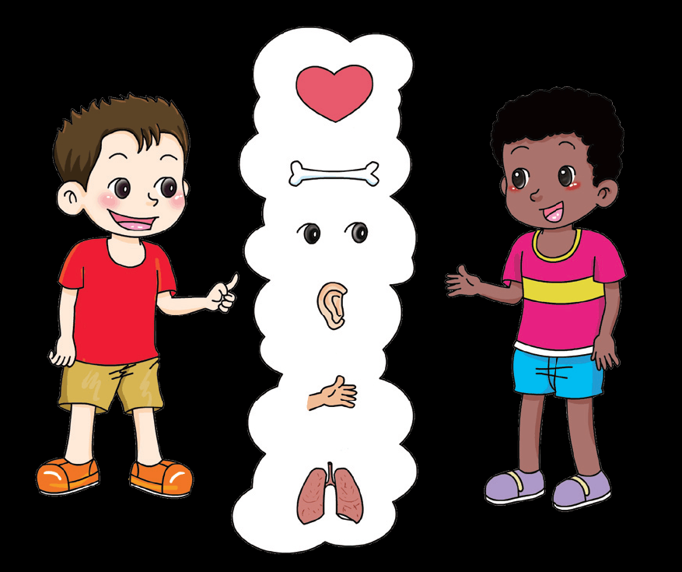
Are we all the same?
How am I like Festus?
How am I like Tom?

Slide 4
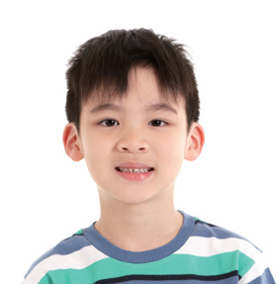
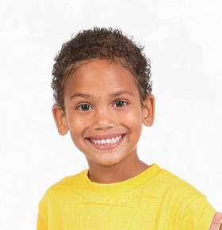
How are we different? Tick(√) or cross (×).
I have a head.
My eyes are blue.
My hair is yellow.
My skin is brown.
I breathe air.
I can laugh.
I sleep.
√
√
√
×
√
×
×
√
×
×
×
√
√
√
√
√
√
√
√
√
√

Slide 5
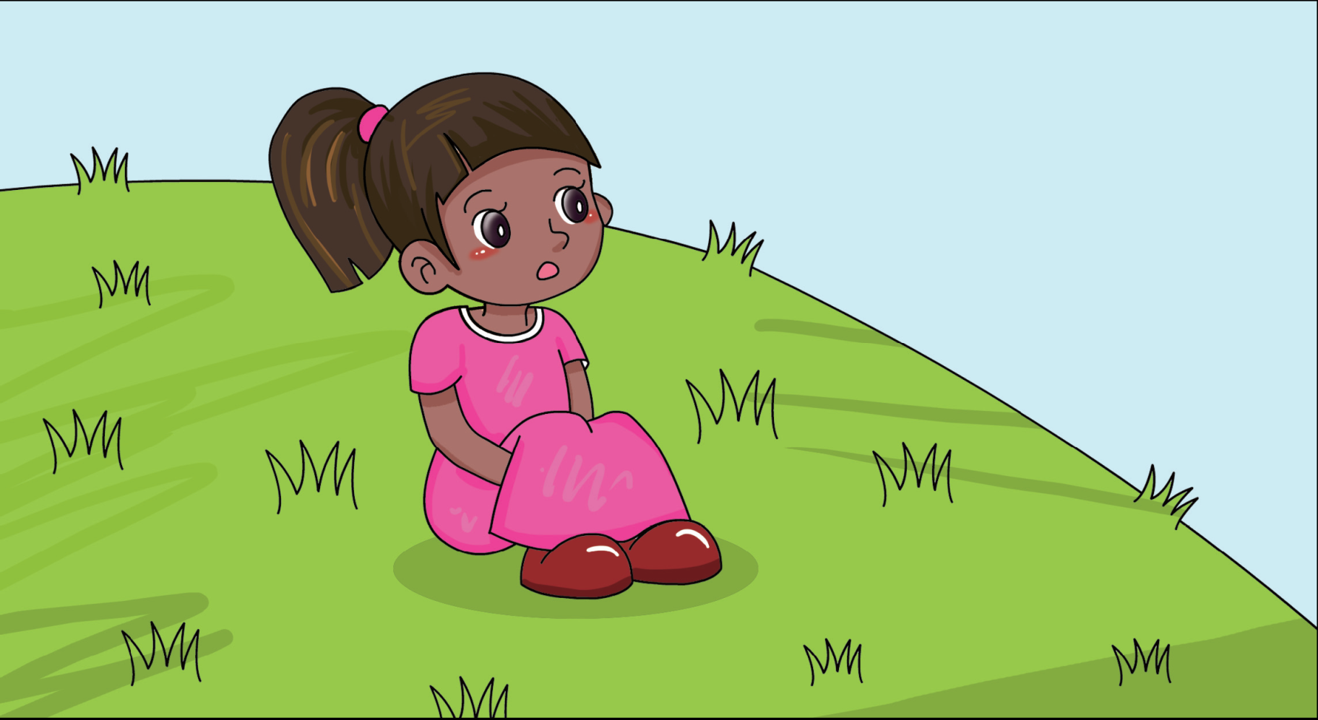
Morgie lives in Africa. How are you like Morgie? Tick (√).
√
I like animals.
√
I don’t like to cry.
√
I like running.
√
I like sunshine.
√
I breathe air.
√
√
I drink water.
√
√
I grow up.
√
√
I go to school.
√

Slide 6
How are we all the same? Sing the song.
Are We All the Same?
Our faces may be different colours.
And we like to play different games.
But we laugh and we like to be happy.
And inside we are all the same.
One heart, two eyes and inside we are all the same, the same.
Two legs, two ears and inside we are all the same.

Slide 7
People in the world look different, but they are just like me.

Slide 8
√
I compared different people in the world.
I talked with people from another country.

Slide 9
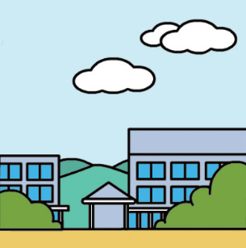
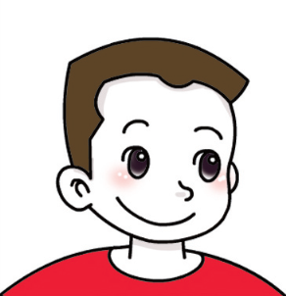
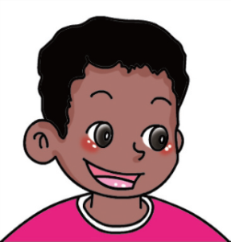
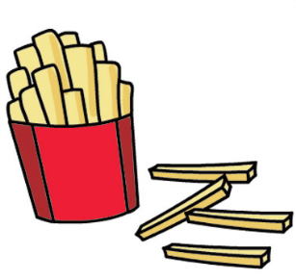
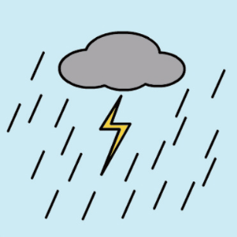
Temu lives in Australia. Make your own drawings next to his.
my school
my school
my friend
my friend
Temu
I like
I like
This is me. My name is _____.
I do not like
I do not like

Slide 10
Workbook

Slide 11
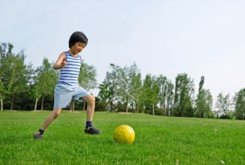
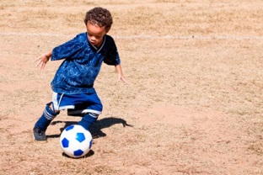
How are the children different? How are they the same? Circle the right words.
They have ( the same / different ) skin colour.
They ( like / do not like ) football.

Slide 12
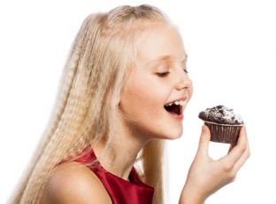
They have ( the same / different ) hair colour.
They ( like / do not like ) cakes.

Slide 13
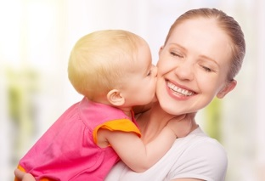
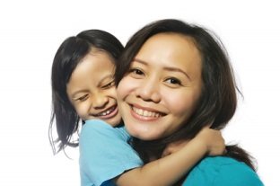
They have ( the same / different ) faces.
They ( love / do not love ) their mothers.

