Slide 1
UNIT 1
YOU AND
ME
你和我

Slide 2
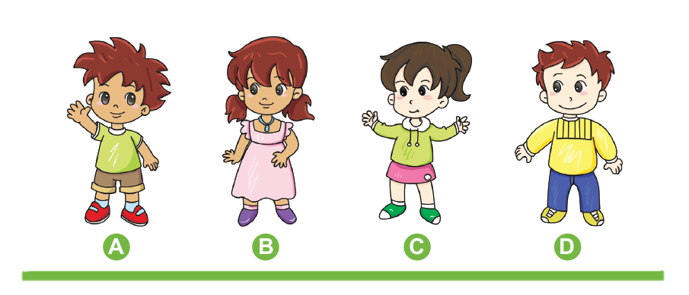
How are they the same? Write the letters.
Who has the same…
Hair colour
Skin colour
Shirt colour
A B D
A B
C D
A C
Who might be brother and sister? Circle them.

Slide 3
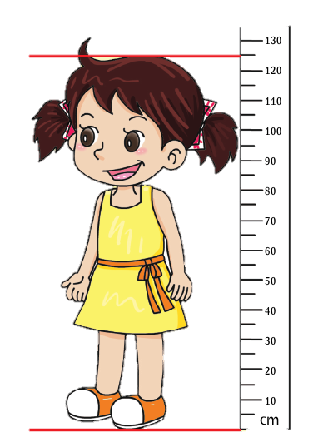
How tall is Mary? ____
How tall will Mary be one
year from now? ____
B
C
100 cm
125 cm
130 cm
150 cm

Slide 4
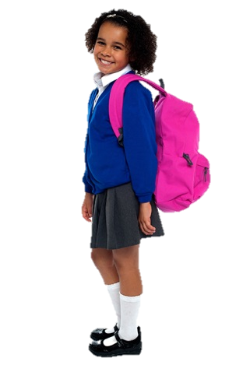
Shazia lives in India. How are you like Shazia? Tick (√).
√
I have two eyes.
√
I have hair.
√
I have teeth.
I have brown skin.
I wear clothes.
√
√
I have fingers.
I go to school.
√
√
I have two feet.

Slide 5
Workbook

Slide 6
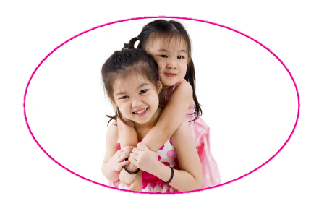
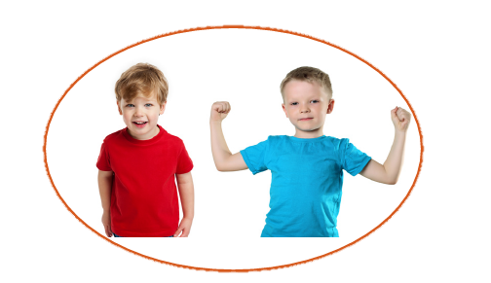
Write the numbers.
Mary and May are twins.
They look the _______.
5
Mike’s shirt is red. John’s shirt is blue. The shirts are ____ colours.
1

Slide 7
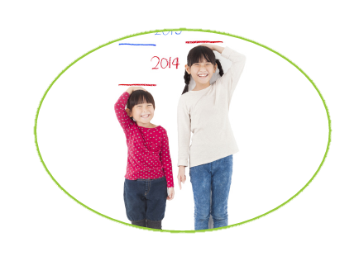
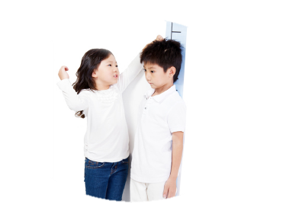
I was small. Now I am big! I can _____.
2
4
How tall am I? Help me _____ my ______.
3

Slide 8
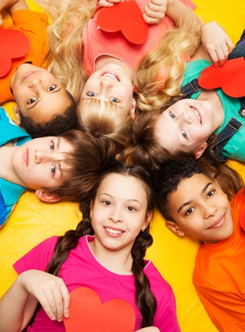
The Big Human Family
People look and sound different. But really we are all the same. We eat food. We play. We laugh. We cry. We love our families and our friends. We are all part of one big human family.

