Slide 1
UNIT 2
SMALL ANIMALS
小动物

Slide 2
I look at a flower.
I look at a leaf.
I see many small animals,
Very different from me.

Slide 3
Lesson 1 Looking Closely
insect (昆虫)
leg (腿)
wing (翅膀)

Slide 4
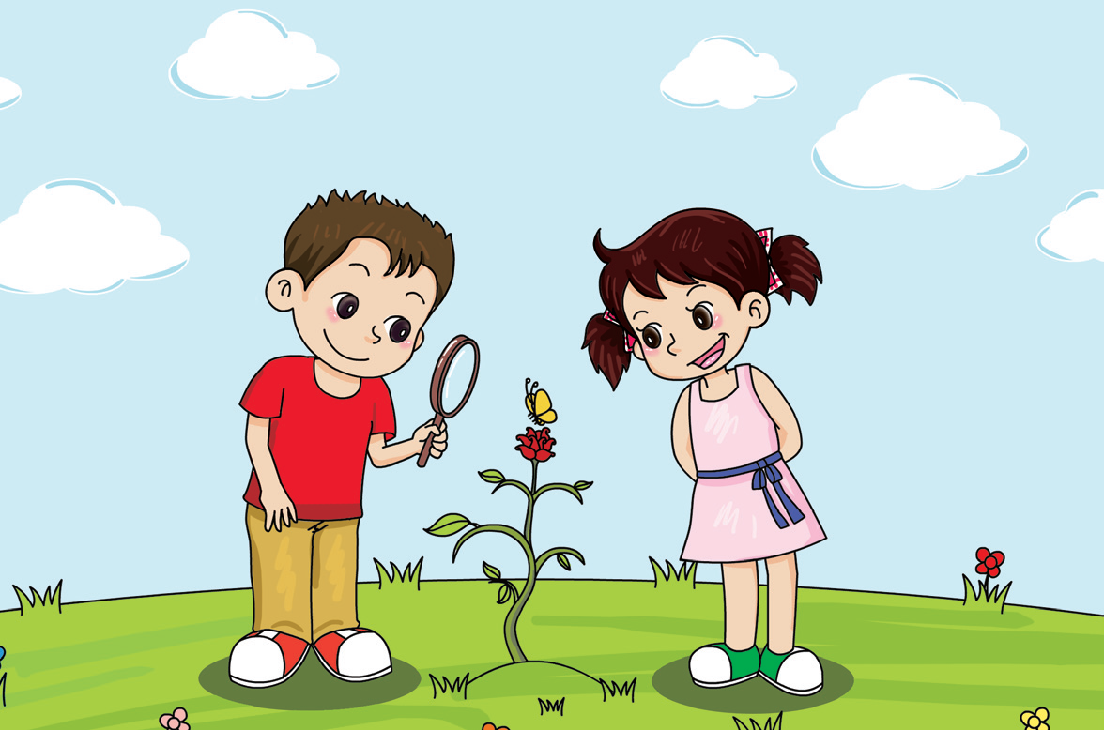
Wow! Look! Its wings are beautiful!

Slide 5
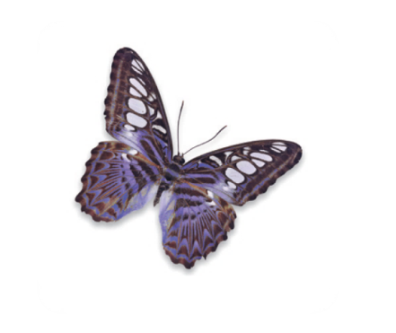
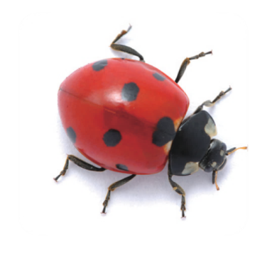
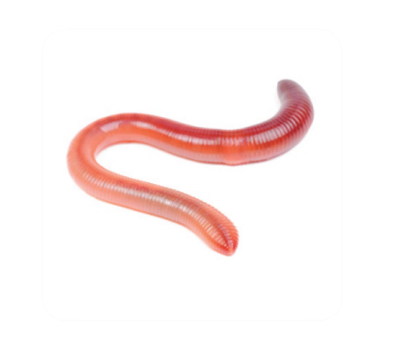
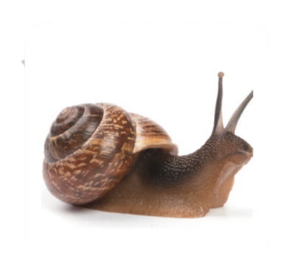
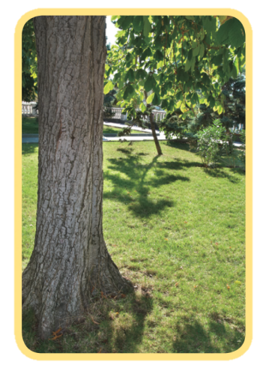
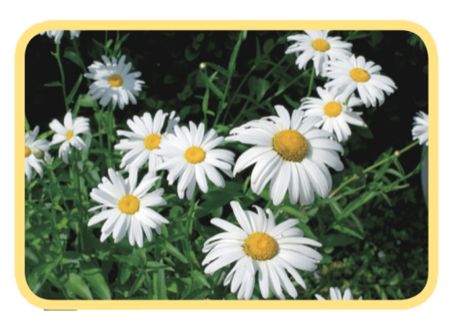
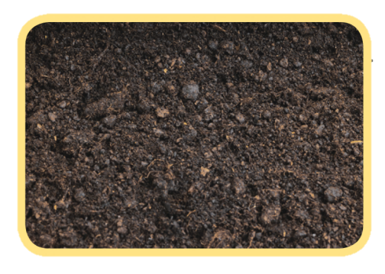
Where can you see these small animals? Draw lines.

Slide 6
Do these small animals have legs or wings? How do they move? Write the numbers.
snail
spider
bee
ant
worm
butterfly
grasshopper
fly
I have legs.
I have wings.
I walk.
I fly.
I crawl.
2, 3, 4, 6, 7, 8
3, 6, 7, 8
2, 3, 4, 6, 7, 8
3, 6, 7, 8
1, 5

Slide 7
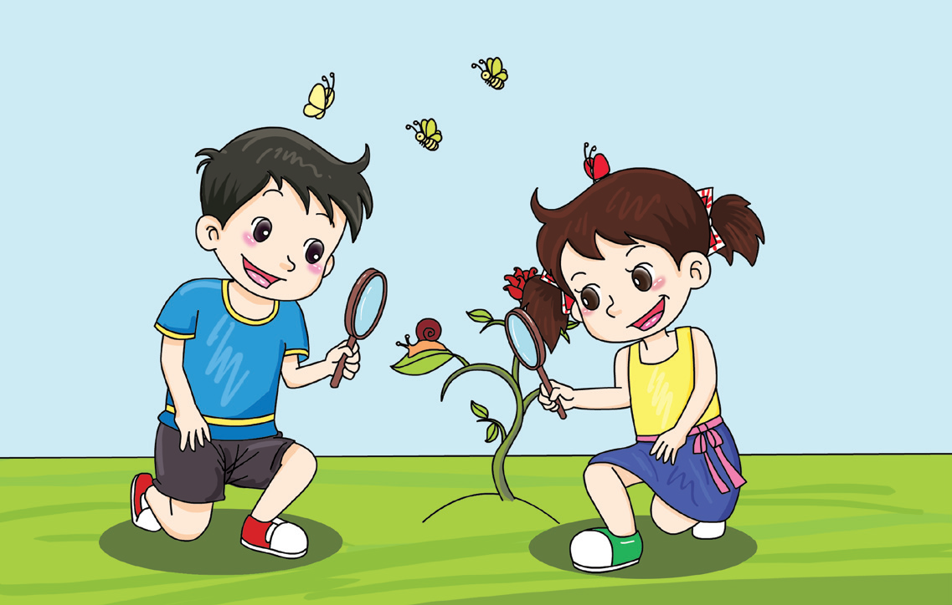
Snails have no legs.
Snails can crawl.

Slide 8
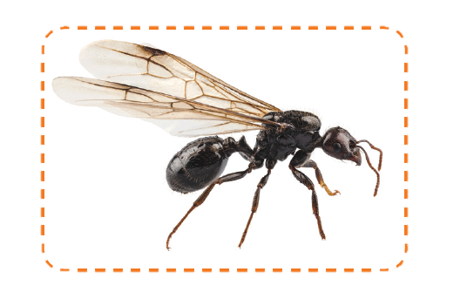
Some ants have wings. They can fly!

Slide 9
How many legs do these small animals have? Write the numbers.
8
_______ ________ ________
0
6
6
6
6
_______ ________ ________
Animals with six legs are called “insects”. Circle them.

Slide 10
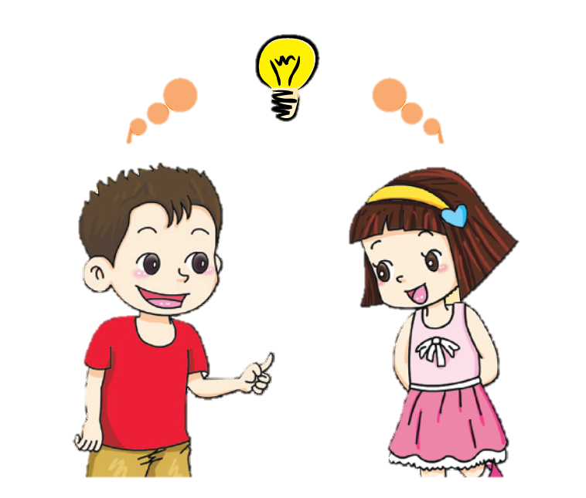
There are many kinds of small animals.
Insects have six legs.

Slide 11
√
I looked for small animals.
√
I observed them with a hand lens.
√
I counted their legs.

Slide 12
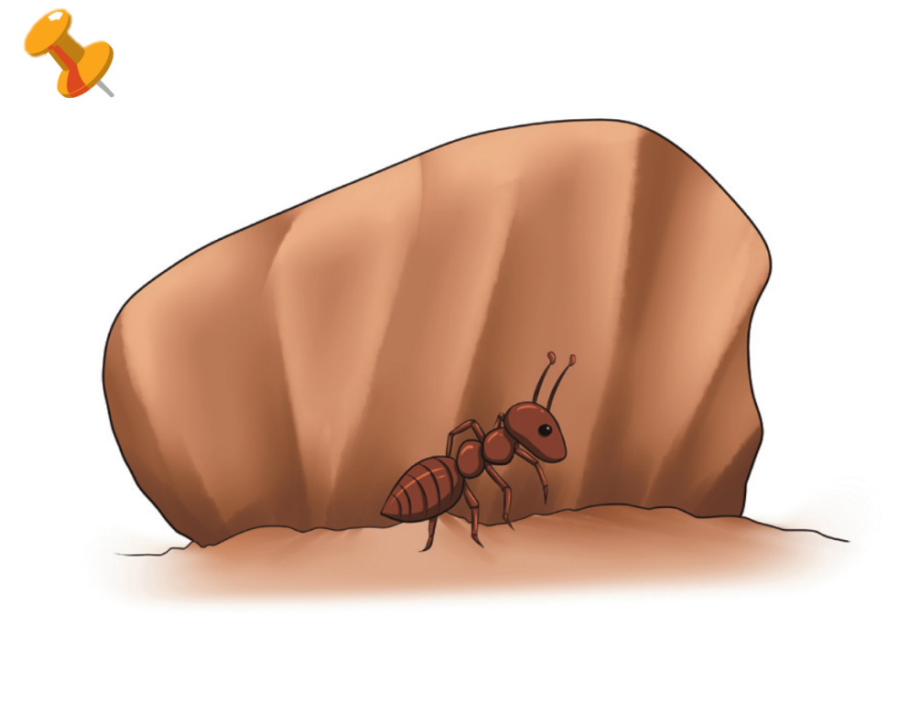
Do you know some small animals? Where can you see them? Draw a picture.

Slide 13
Workbook

Slide 14
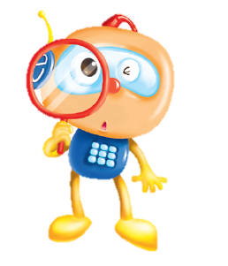
Which animals are insects? Tick (√).
√
√
√
Remember to count the legs!

