Slide 1
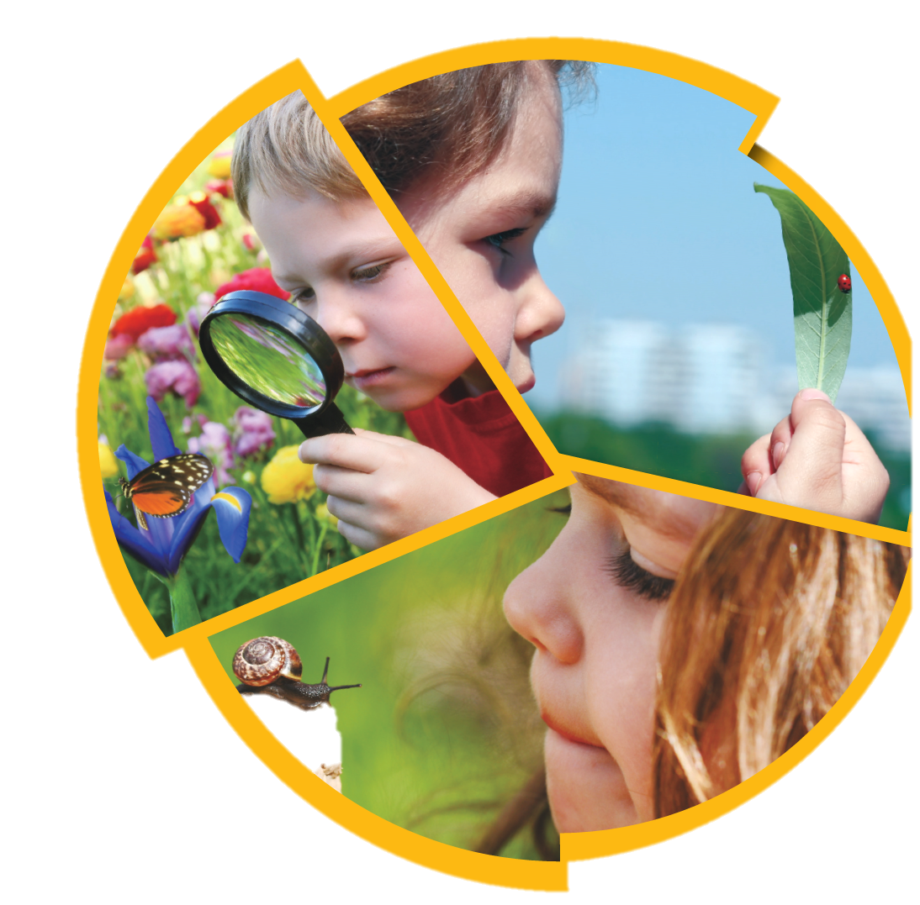
UNIT 2
SMALL ANIMALS
小动物

Slide 2
Lesson 3 Finding Small Animals
bush (灌木丛)
grass (草地)
pond (池塘)
stone (石头)

Slide 3
What can you see around a small pond?

Slide 4
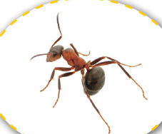
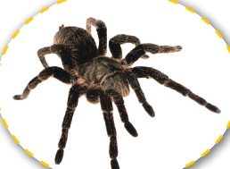
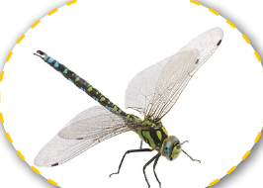
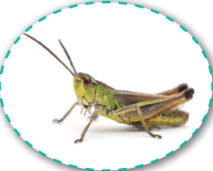
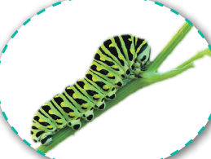
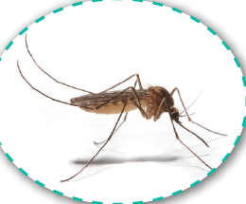
Where do these small animals live? Draw lines.
grass
bushes
stones
pond

Slide 5
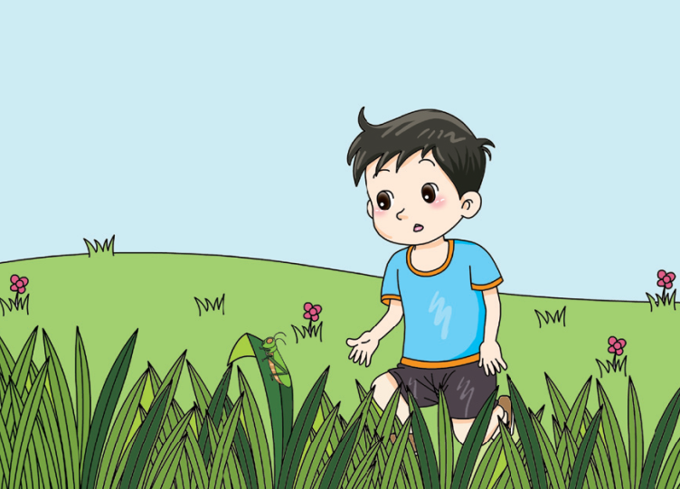
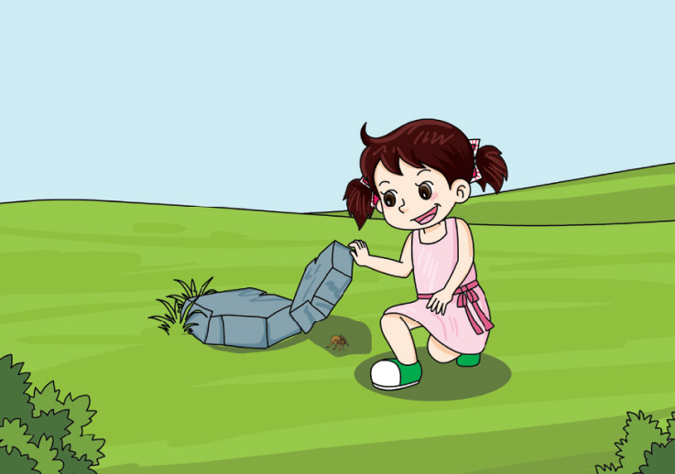
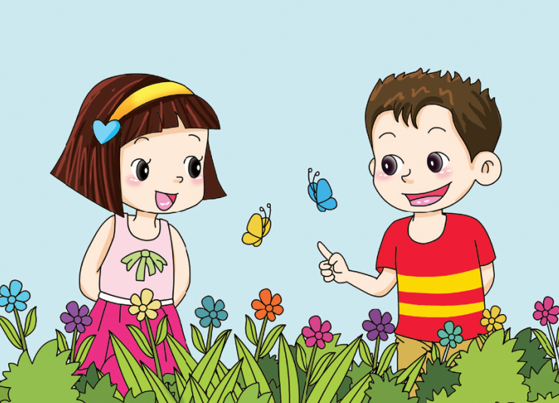
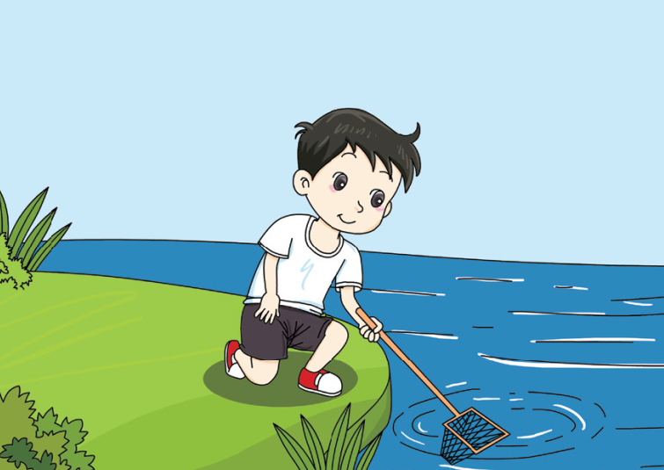
What small animals can you find? Draw a picture.
Let’s look in
long grass.
Let’s look under
stones.
Let’s look in these
bushes.
Let’s look in a pond.

Slide 6
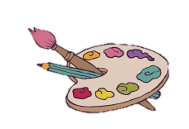

Slide 7
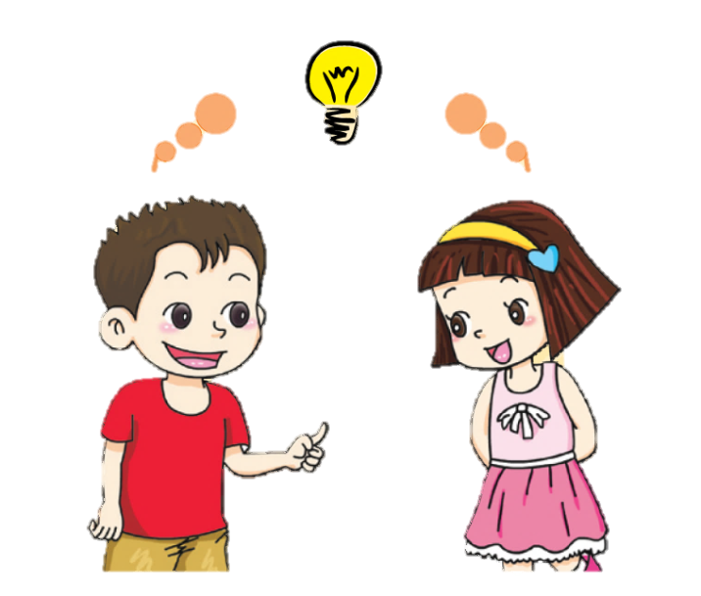
Some small animals live under stones. Some live in long grass. Some live on bushes. Some live in ponds.

Slide 8
√
I looked for small animals.
√
I observed them closely.
I did an experiment with insects.

Slide 9
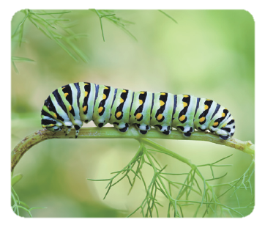
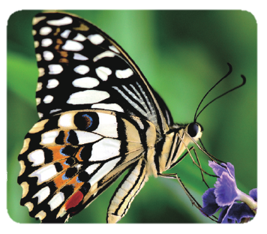
A caterpillar grows and changes into a butterfly. Which is right? Tick (√).
I have six legs.
I can crawl.
I can fly.
I eat leaves.
I eat nectar.
×
√
√
×
×
√
√
×
×
√

Slide 10
Workbook

Slide 11
Where can you find these small animals? Talk to your friends.
grasshopper
bee
spider
dragonfly
mosquito
snail

Slide 12
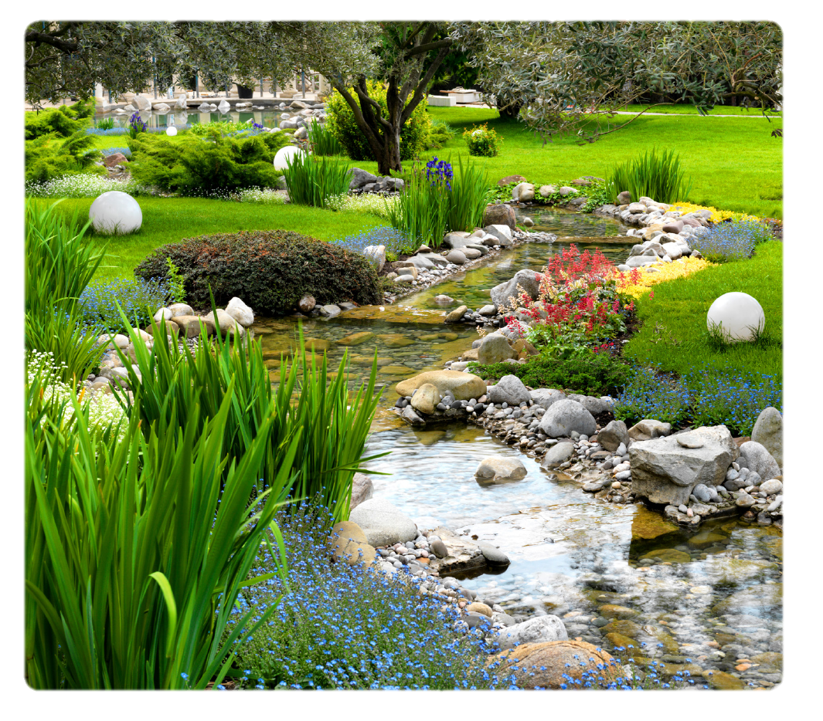
Possible answer:
You can find the grasshopper in the grass. You can find the bee in the flowers. You can find the spider in the trees or bushes, or on the rocks. You can find the dragonfly flying above the water or resting in the grass. You can find the mosquito near the water. You can find the snail on the rocks, or in the bushes or trees, or in water.

