Slide 1
UNIT 2
SMALL ANIMALS
小动物

Slide 2
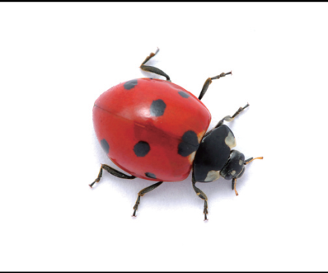
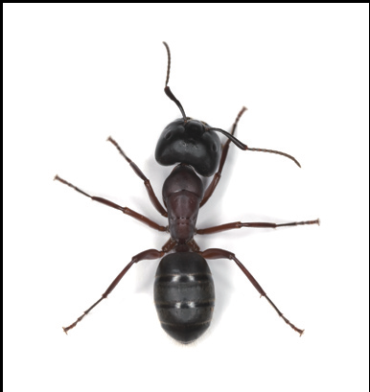
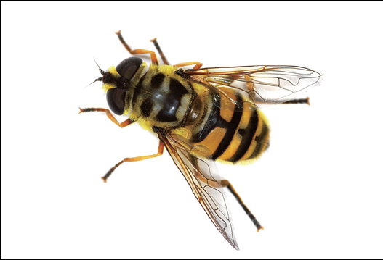
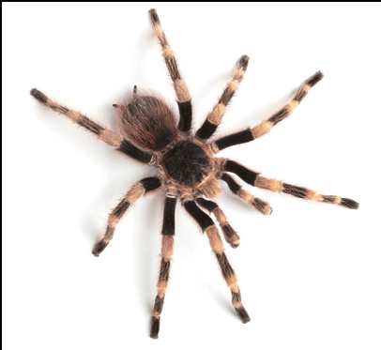
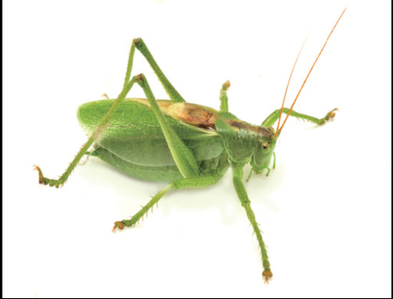
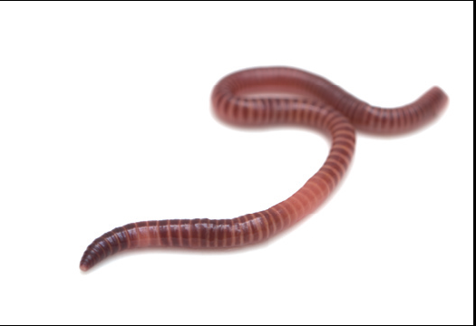
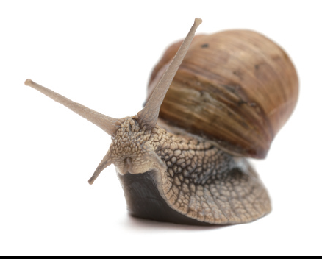
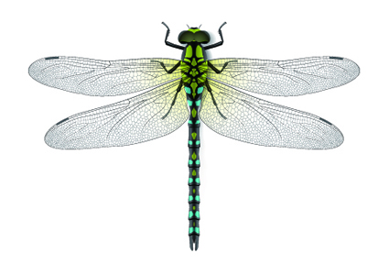
A
B
C
ladybird
ant
bee
D
E
F
spider
grasshopper
worm
G
H
I
snail
butterfly
dragonfly

Slide 3
How many legs do these small animals have? Write the letters.
F G
A
B C E H I
D
no legs
six legs
eight legs

Slide 4
How do they move? Write the letters.
A
B C D E H I
F G
A
C E H I
I walk.
I crawl.
I fly.

Slide 5
Where can you find them? Write the letters.
D G
A
B D G
A B C H
B F G I

Slide 6
Workbook

Slide 7
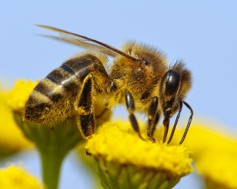
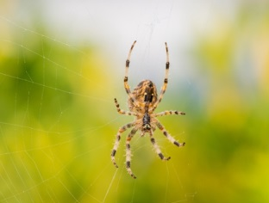
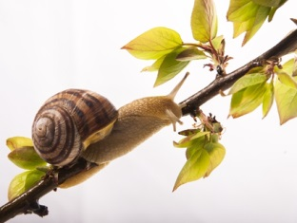
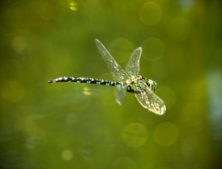
Write the letters.
I am a bee. I have six ___. I am a(n) ___.
E
I am a(n) ___. I use a(n) ___ to catch food.
D
F
C
I am a snail. You can see me on a(n) ___.
I am a dragonfly. I have ___, so I can ___.
G
B
A

Slide 8
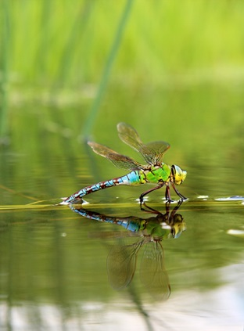
The Dragonfly’s Habitat
Every animal lives in a special place. That place is called its habitat. The dragonfly’s habitat is a place near water. Think of some animals. What are their habitats?
Possible answer:
Ants live in the ground. Fish live in water. Pandas live in bamboo forests. These places are these animals’ habitats.

