Slide 1
UNIT 3
MAGNETS
磁铁

Slide 2
I can push, I can pull.
I am a magnet.
I repel, I attract.
I am a magnet.

Slide 3
Lesson 1 Magic Magnets
attract (吸引)
magnet (磁铁)

Slide 4
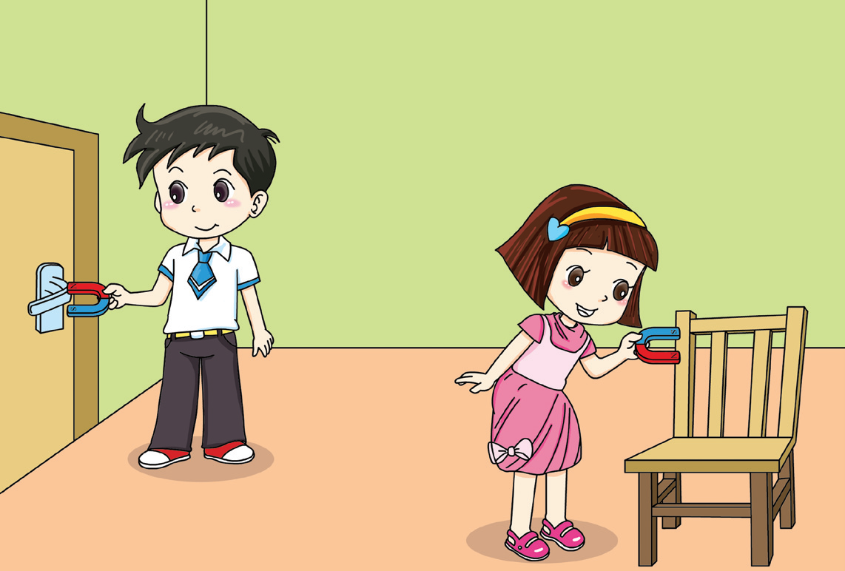
Where can a magnet stick?
My magnet sticks to the door handle.
My magnet doesn’t stick to the wooden chair.

Slide 5
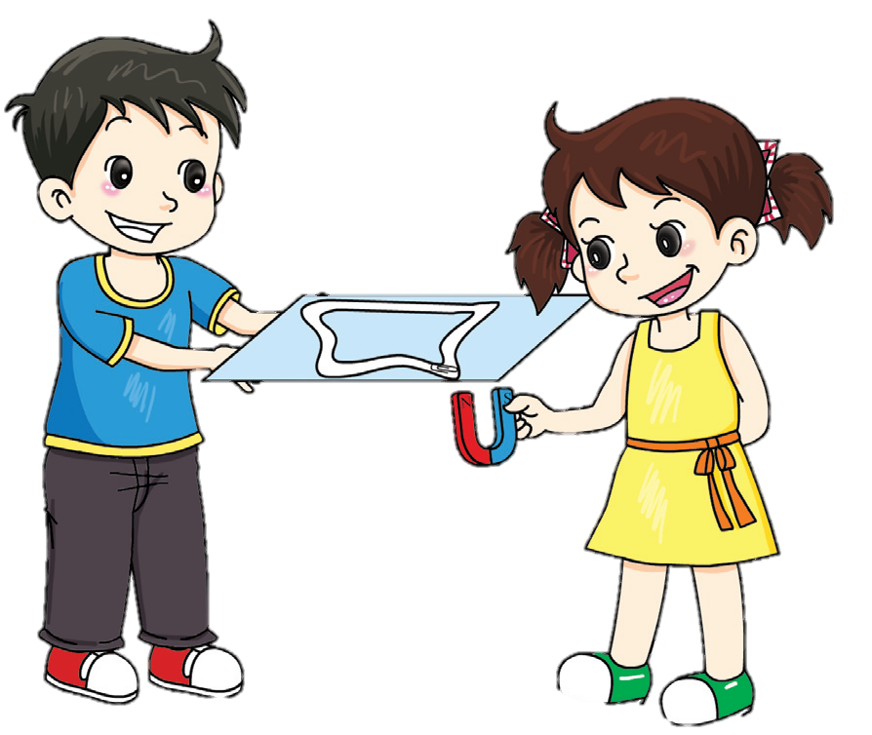
Put a magnet under a piece of paper. Don’t touch the paper with the magnet. Can your paperclip move around the racetrack?
Can magnets attract things without contact?

Slide 6
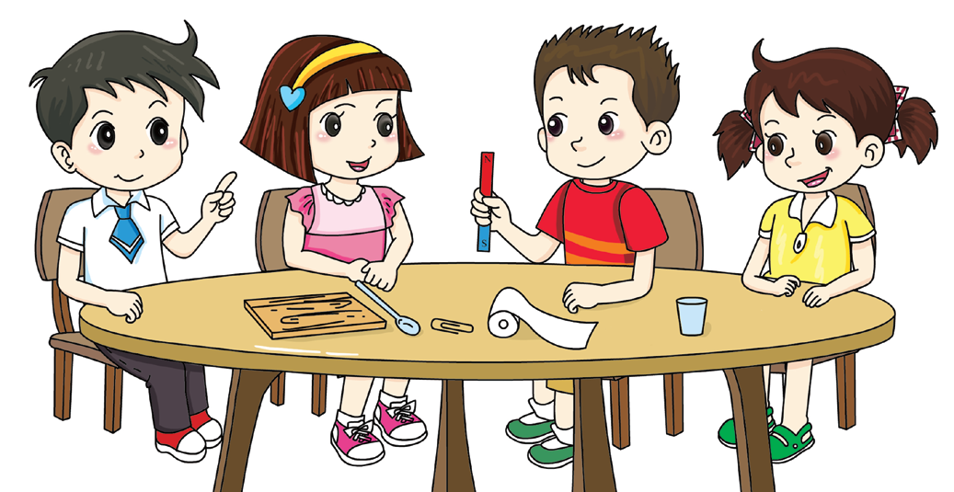
Which materials can the magnet attract? What do you think?
I think the magnet can attract iron.
Let’s find out.

Slide 7
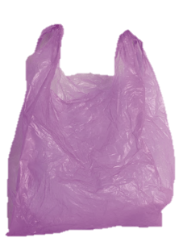
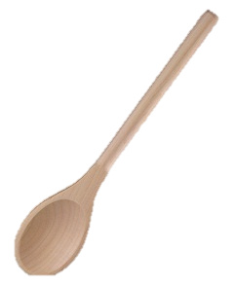
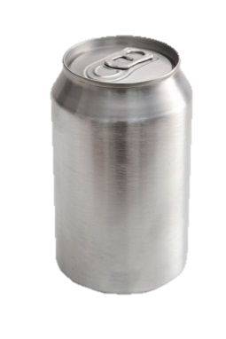
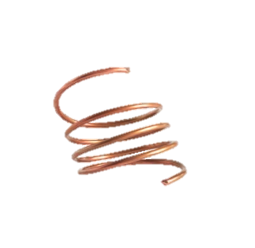
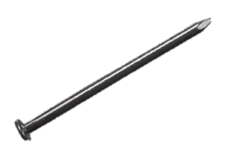
Write the numbers.
plastic
wood
paper
iron
aluminium
copper
I think the magnet can attract __________.
4

Slide 8
Use the magnet to attract the materials. What did you find? Write the numbers.
The magnet can attract ________________.
4

Slide 9
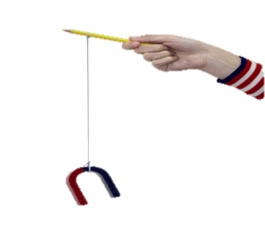
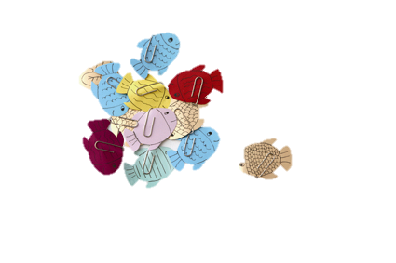
Make a magnetic fishing rod.
Make some paper fish. Add a metal paperclip to each fish.

Slide 10
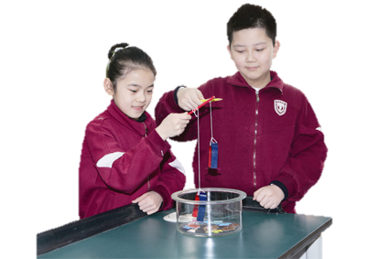
Take turns to fish. How many fish did you catch? Write it down.
_________
Can we play this game with plastic paperclips?

Slide 11
Magnets can attract some things without contact. Magnets can attract some metal materials.

Slide 12
I read a book.
I tested some materials with my magnet.
√

Slide 13
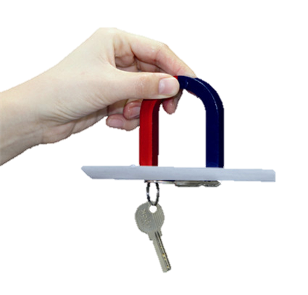
Can a magnet attract keys through a piece of paper? What about two or more? Draw your results.

Slide 14
Workbook

Slide 15
Which material can a magnet attract? Tick (√).
copper
wood
glass
√
iron
paper
gold

