Slide 1
UNIT 3
MAGNETS
磁铁

Slide 2
Lesson 2 Attract and Repel
attract (吸引)
north (北)
pole (磁极)
repel (排斥)
south (南)

Slide 3
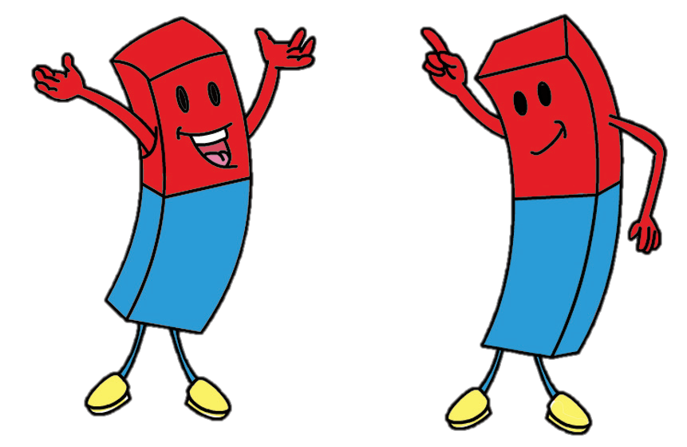
Two magnets meet. What happens?
Hi!
Hi!

Slide 4
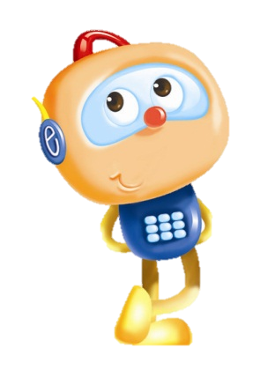
Can two magnets attract? Can two magnets repel?
Can you feel the force?

Slide 5
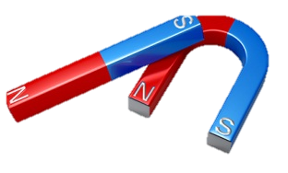
Magnets have two ends. We call them “poles”. We label them N (north) and S (south).

Slide 6
What happens when you push two poles together? Circle the right words.
 | Same poles ( attract / repel ).
 | Different poles ( attract / repel ).
Can you feel the force? Are they pushing or pulling?

Slide 7
Two magnets meet. What happens? Sing the song.
Magnet, magnet, what can you do?
You attract and repel too.
Two north poles will push away.
North and south will pull and stay.
Magnet, magnet, what can you do?
You attract and repel too.
Attract and Repel

Slide 8
Magnets have two poles.
Same poles repel. Different poles attract.

Slide 9
I observed magnets closely.
I pushed the poles of two magnets together and observed closely.
I did a fair test.
√
√

Slide 10
Workbook

Slide 11
Circle the right words.
These magnets ( attract / repel ).
These magnets ( attract / repel ).
These magnets ( attract / repel ).
These magnets ( attract / repel ).

