Slide 1
UNIT 3
MAGNETS
磁铁

Slide 2
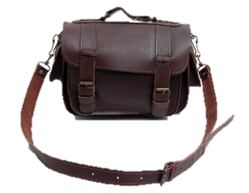
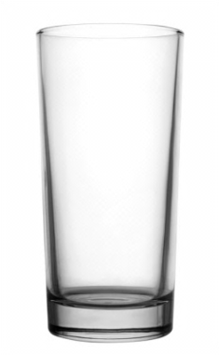
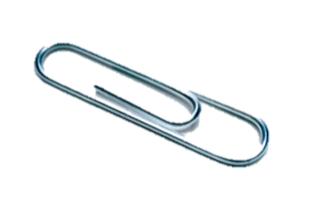
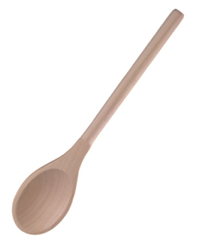
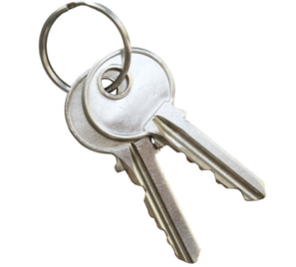
Which materials can the magnet attract? Tick (√).
√
√

Slide 3
B
Which two magnets will attract each other?_______
A.
B.

Slide 4
B
Two magnets repel each other. They________.
pull towards each other
push away from each other
neither push nor pull

Slide 5
Workbook

Slide 6
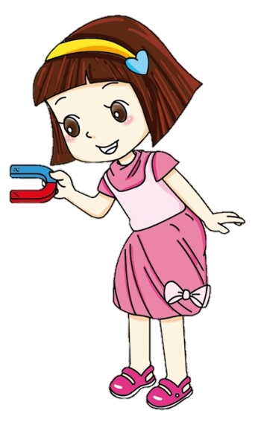
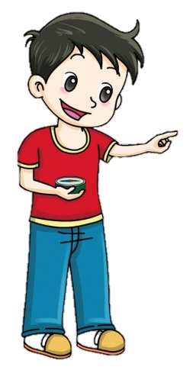
Write the numbers.
This is a ______. It has two______.
Different poles ______. Same poles ______.
5
6
1
2
This is a ______. It can point
______ and ______.
7
3
4

Slide 7
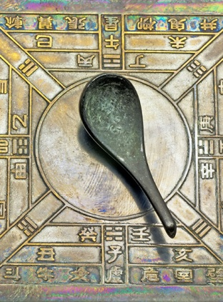
The First Compass
The compass was invented in China long ago. When you spin the spoon, it moves around. When it stops, the handle of the spoon points south. That’s why we call it a “si nan” in Chinese.
What is the spoon made of?
Possible answer:
The spoon is made of a special magnetic rock. The rock is called “lodestone”. It points south because it is magnetic.

