Slide 1
UNIT 4
SOIL AND ROCKS
土壤和岩石

Slide 2
I can be round,
I can be small.
I can be sharp,
I can be tall.
You can find me in a strong wall.
What am I?

Slide 3
Lesson 1 Kinds of Soil
soil (土壤)
stone (石头)
sand (沙子)

Slide 4
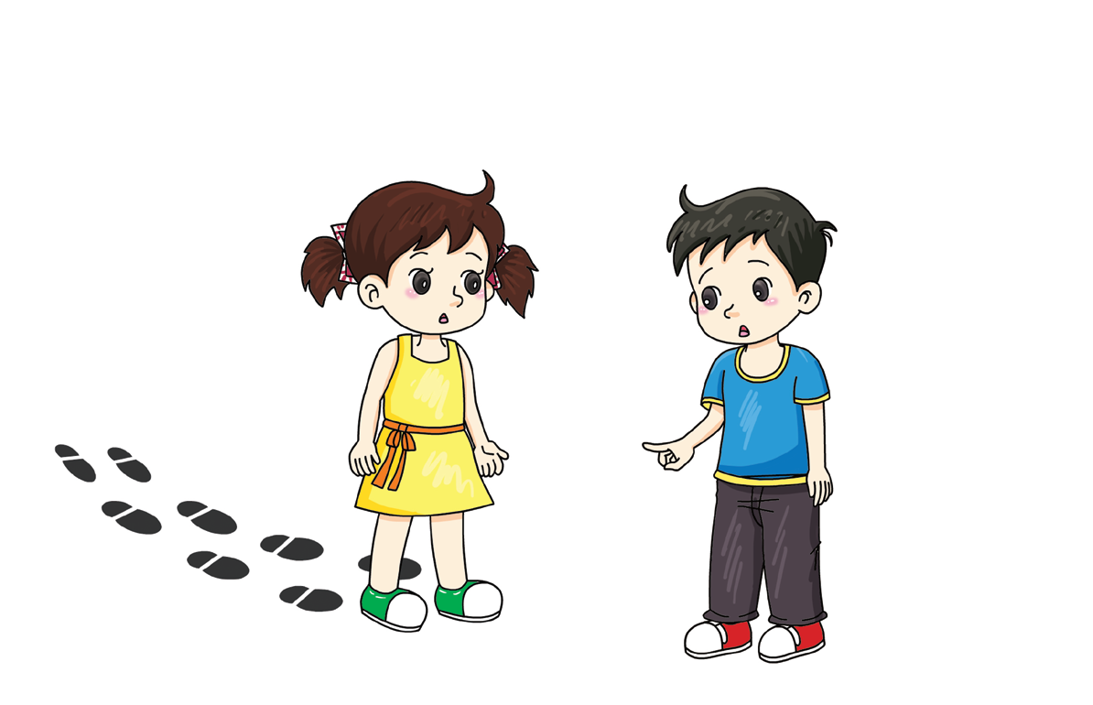
Look at your muddy shoes. Where does this mud come from?

Slide 5
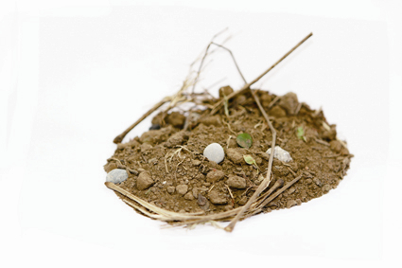
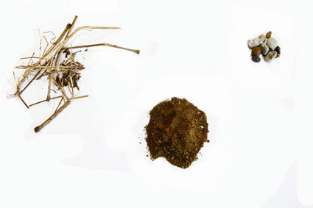
What is in the soil?
Test 1
Separate the soil into different parts on your table.
Does soil have a smell? Can soil make a sound?

Slide 6
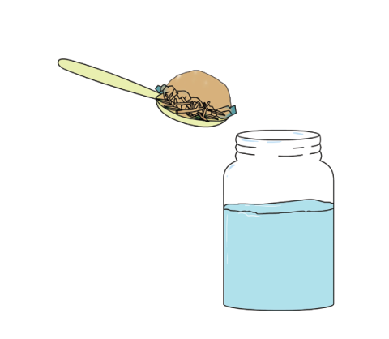
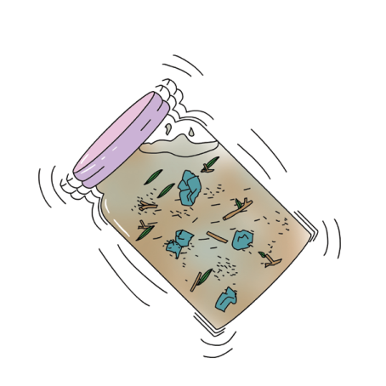
Test 2 Use water to separate the soil into different parts.
Put the soil into a bottle of water.
Add the lid and shake it.

Slide 7
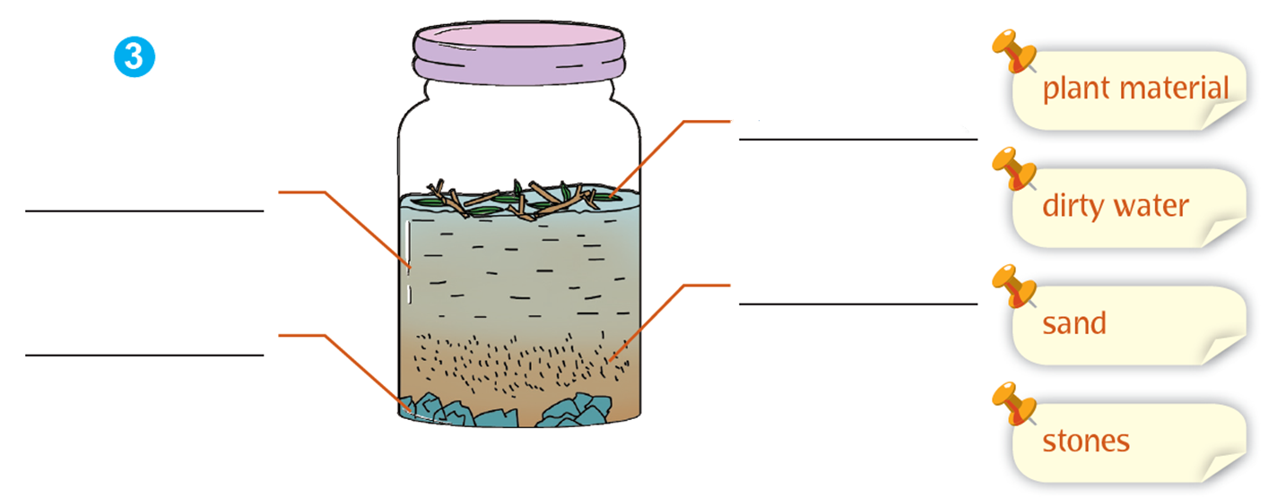
plant material
dirty water
sand
stones
Observe the bottle and the soil. Copy the labels.

Slide 8
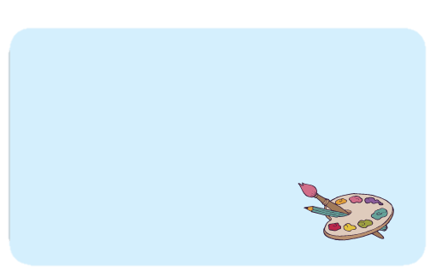
Collect two kinds of soil. How are they different? How are they the same?
Test 1
Separate the soil into different parts on your table. What can you see? Draw the results.

Slide 9
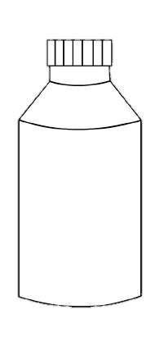
Test 2
Use water to separate the soil into different parts. What can you see? Draw the results.
Which soil contains the most plant material? Which soil contains the largest stones?

Slide 10
Let’s go for a walk. What is under our feet? Sing the song.
Under Our Feet
Walk on the soil, under our feet.
Walk on the soil, under our feet.
With sand and stones and pieces of wood,
With grass and leaves and slippery worms,
That’s the soil, under our feet.
Walk on the soil.

Slide 11
I can see stones, sand and plant material in the soil.
There are different kinds of soil.

Slide 12
I separated the soil into different parts.
I compared different kinds of soil.
I watched a video.
√
√

Slide 13
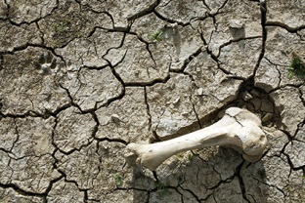
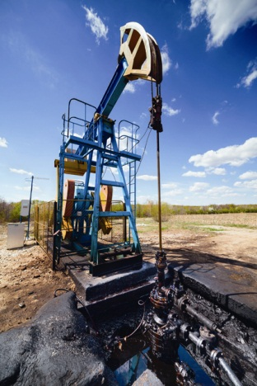
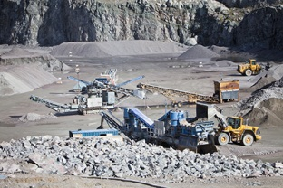
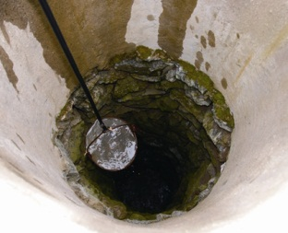
What is under the soil?
bone
oil
rocks
water

Slide 14
Workbook

Slide 15
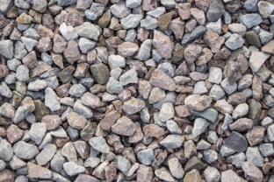
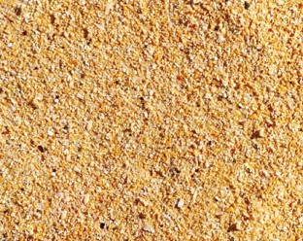
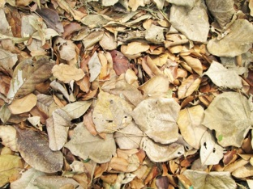
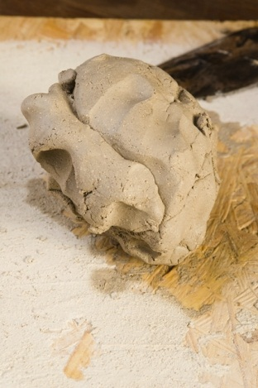
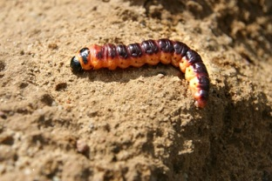
What can you find in soil? Tick(√).
√
√
√
√
√

