Slide 1
UNIT 4
SOIL AND ROCKS
土壤和岩石

Slide 2
Lesson 2 Rocks
rock (岩石)
rough (粗糙的)
smooth (光滑的)
speckled (布满斑点的)
striped (带条纹的)

Slide 3
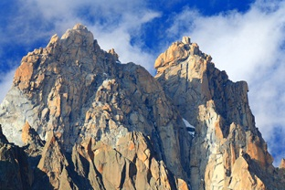
Look at the mountains. What are they made of?

Slide 4
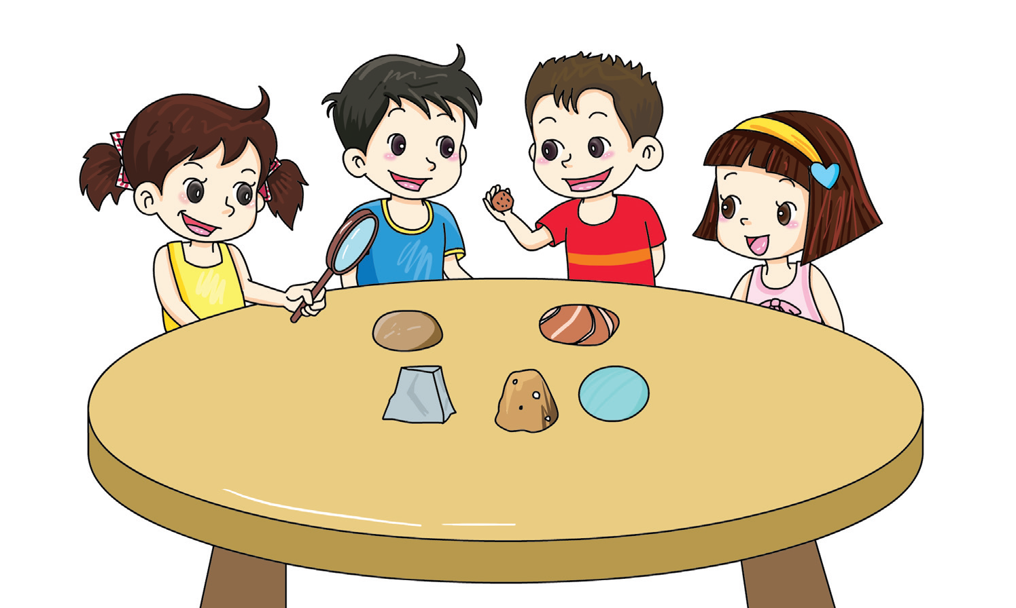
Observe some different rocks.
It is brown.
It feels rough.

Slide 5
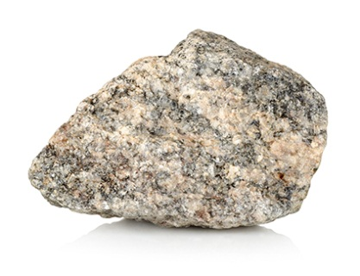
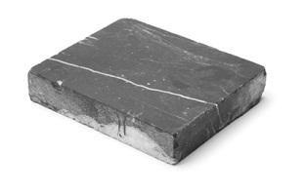
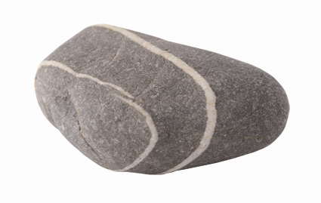
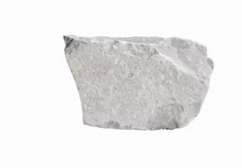
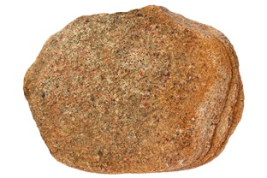
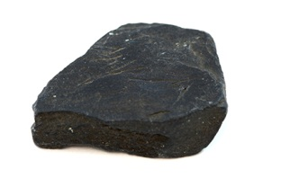
How do they look? How do they feel? Draw lines.
rough
smooth
grey
speckled
striped

Slide 6
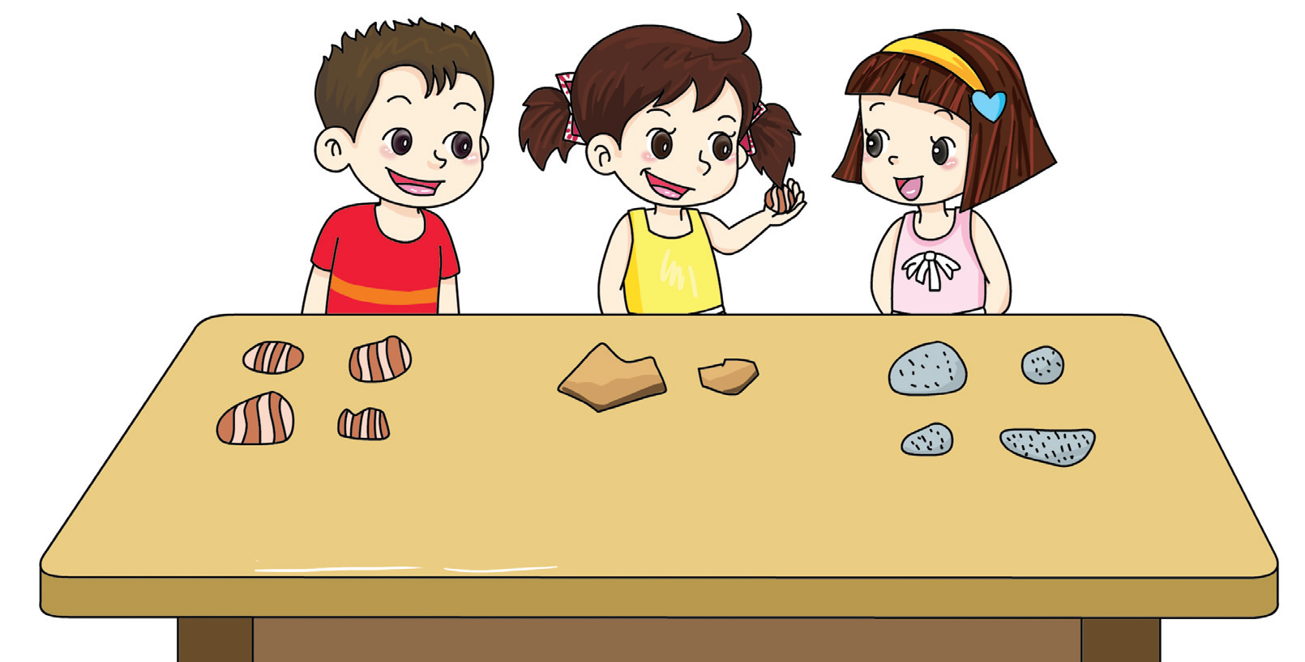
Collect some stones and rocks. How do you group them together?
Where does this stone go?

Slide 7
Draw your results.

Slide 8
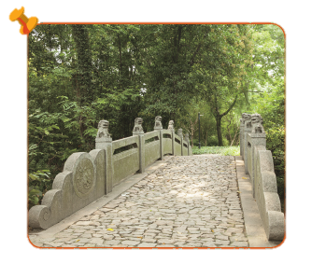
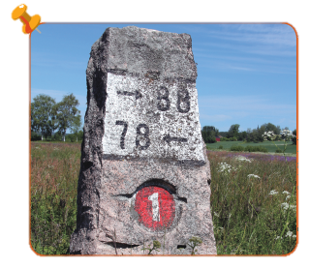
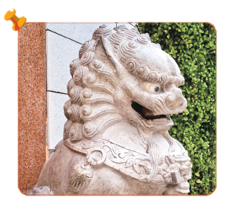
How do we use stones and rocks?

Slide 9
There are many different kinds of rocks.
Rocks have many uses.

Slide 10
√
I observed rocks.
I weighed rocks.
I grouped different kinds of rocks by some features.
√

Slide 11
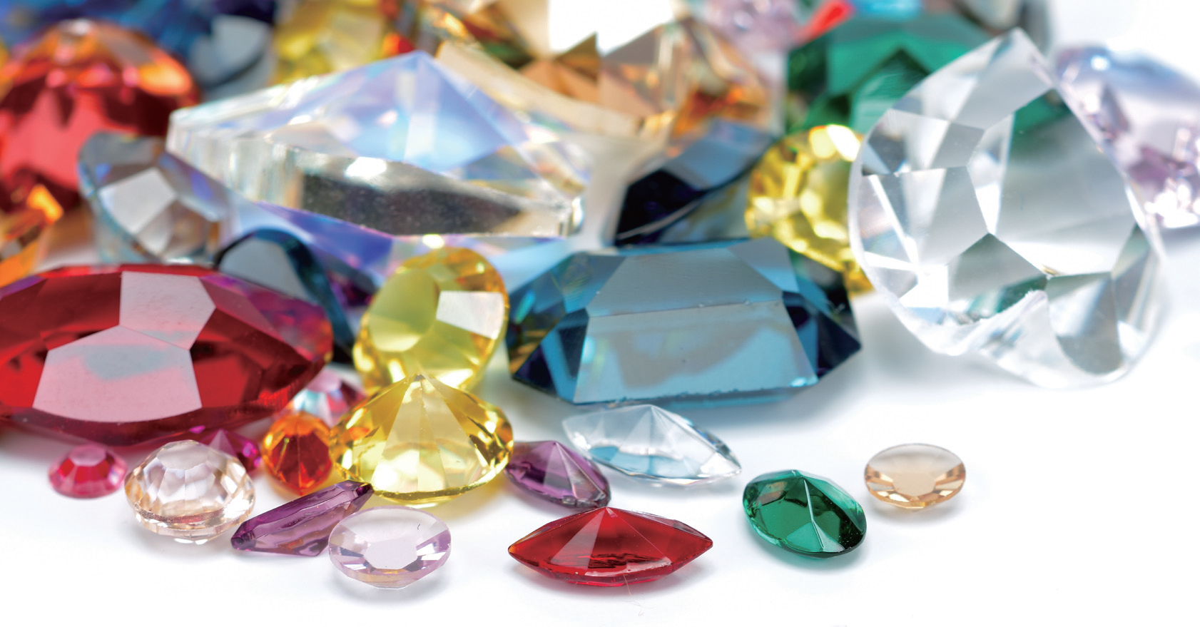
These are all stones. They have beautiful colours. Some stones can sparkle. Where can you see these stones?

Slide 12
Workbook

Slide 13
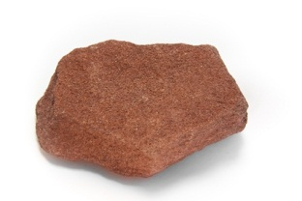
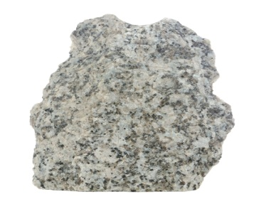
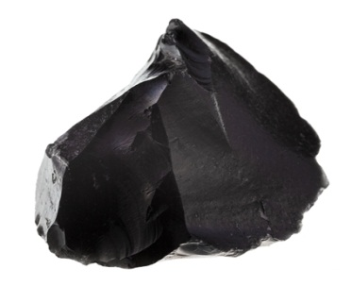
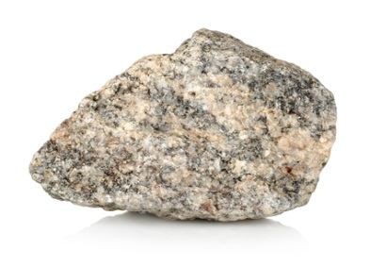
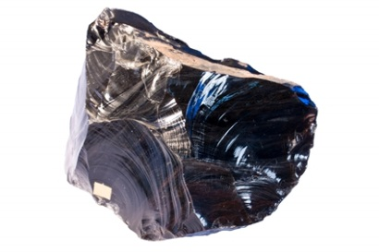
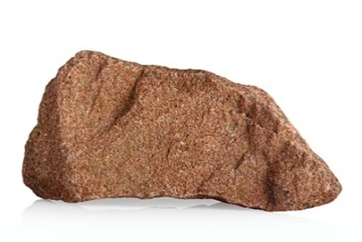
Which rocks are in the same group? Draw lines.

