Slide 1
UNIT 4
SOIL AND ROCKS
土壤和岩石

Slide 2
Lesson 3 Do They Drain Equally Well?
drain (排水)

Slide 3
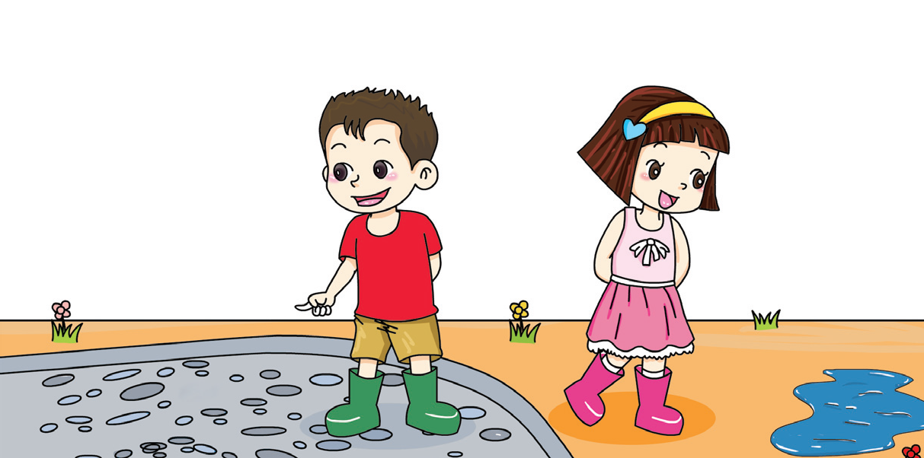
Why do some puddles drain quickly?
There was a puddle here.
Now it is gone.
This puddle is still here.

Slide 4
Can water pass through soil, sand and stones? Do they drain equally well?
How can you make a fair test?
We should add the same amount of water.
We should add the same amount of soil, sand and stones.

Slide 5
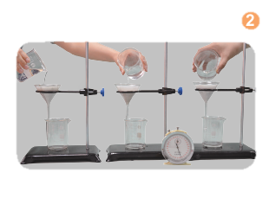
What to do
1
Add some soil, sand and stones into each funnel. Put each funnel into a beaker.
soil sand stones
2
Gently pour some water over the soil, sand and stones.
soil sand stones

Slide 6
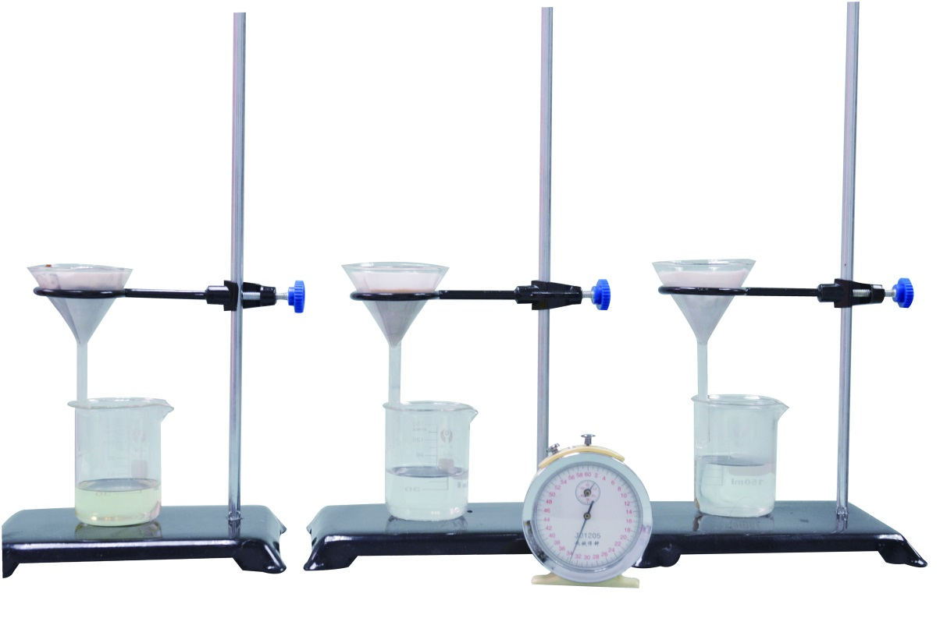
3
When will the water stop dripping through the funnels? Measure the time.
soil sand stones

Slide 7
Results
How long does it take for water to pass through them?
 | Time(min)
Soil
Sand
Stones
Conclusion
Stones
________ can drain water best.

Slide 8
Stones drain water best.

Slide 9
I did a fair test.
I watched a video.
I observed the experiments closely.
√
√

Slide 10
Workbook

Slide 11
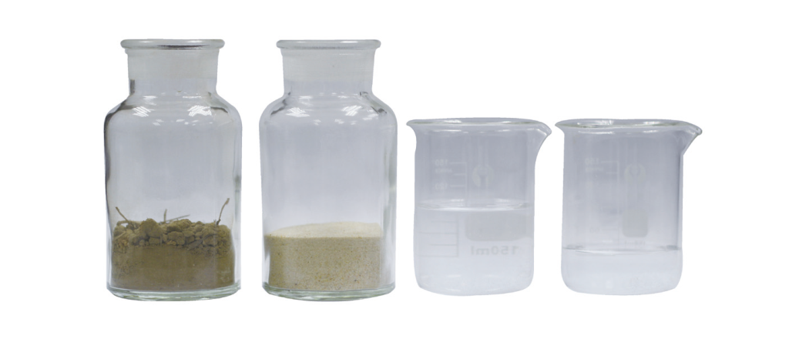
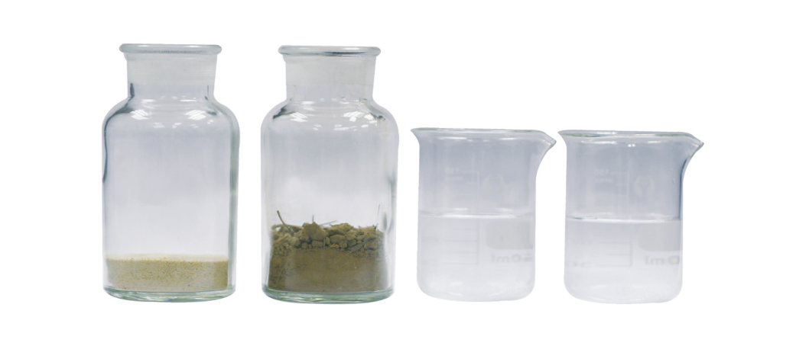
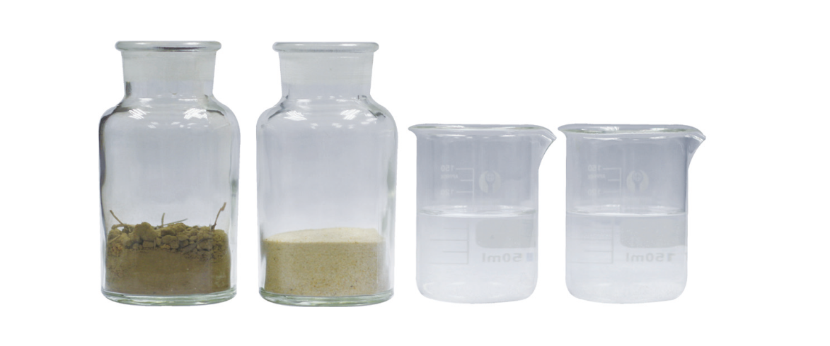
You want to know which soil can drain water better. Which materials give a fair test? Tick (√).
√

