Slide 1
UNIT 4
SOIL AND ROCKS
土壤和岩石

Slide 2
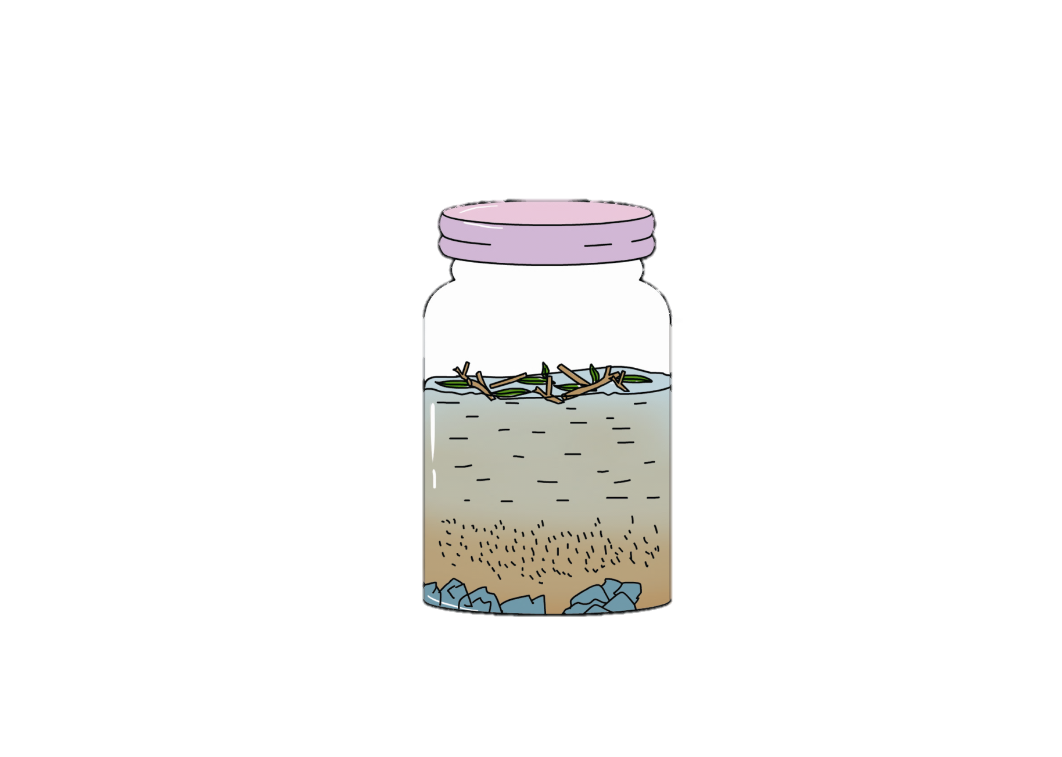
Mary used water to separate the soil into different parts. What can she see? Draw lines.
sand
stones
dirty
water
plant material

Slide 3
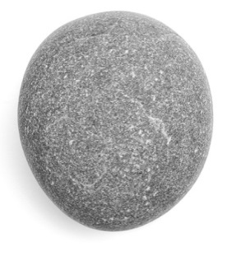
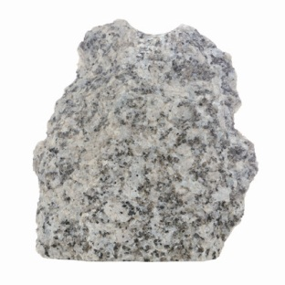
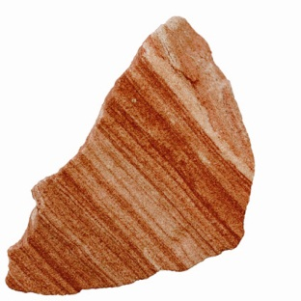
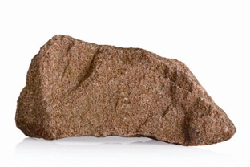
How do these rocks look? How do they feel? Draw lines.
rough
grey
speckled
striped

Slide 4
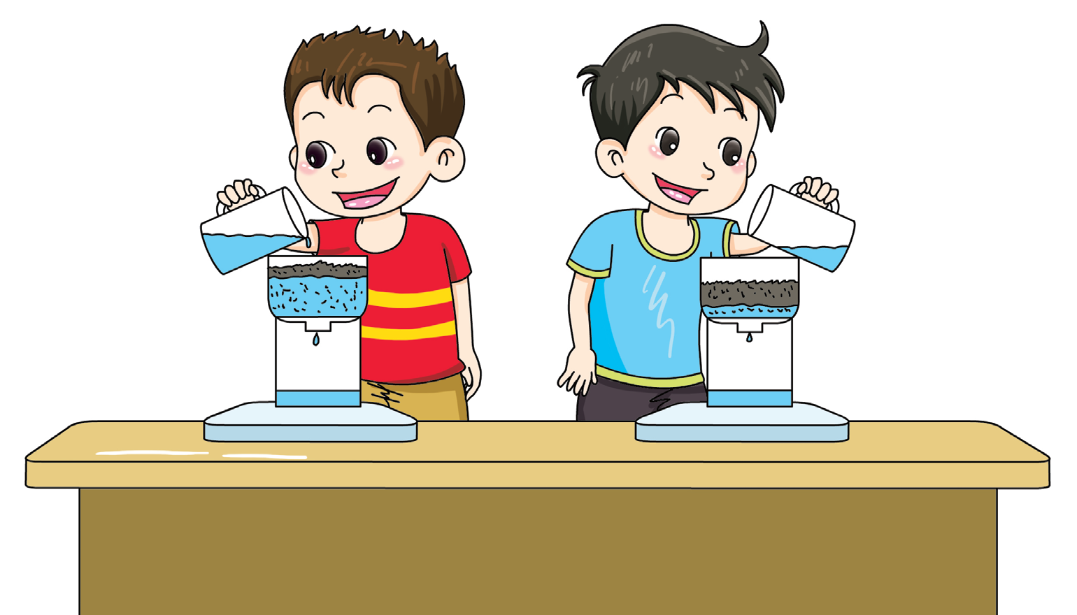
Tom and Bob tested two kinds of soil. They wanted to know which soil can drain water better.
I want to add 250 ml of water.
I want to add 50 ml of water.
Was this a fair test?

Slide 5
How can you make the test fairer? Draw a picture.

Slide 6
Workbook

Slide 7
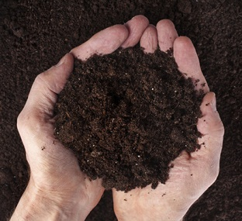
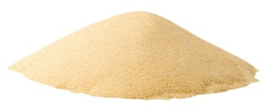
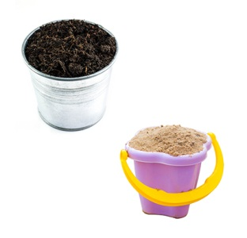
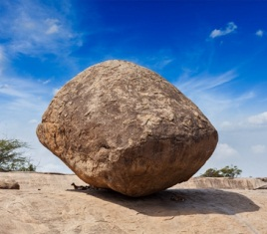
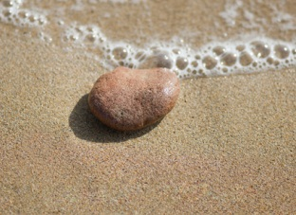
Write the numbers.
drain
rock
sand
soil
stone
4
This is_____.
3
1
This is ____.
Sand can ____ water better.
2
5
A _____is big.
A _____is small.

Slide 8
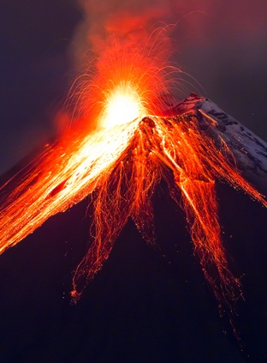
Rocks from Fire
Some kinds of rocks are made when volcanoes erupt. The material in volcanoes is hot. When it comes out, it cools down and makes rocks.
Do you know other rocks? How are they made?
Possible answer:
Another kind of rock is called “sedimentary rock”. It forms by being squashed in layers. Water and wind carry very small pieces of rock away. The pieces collect together in places. When there is a lot of this material, it gets very heavy and forms rock.

