Slide 1
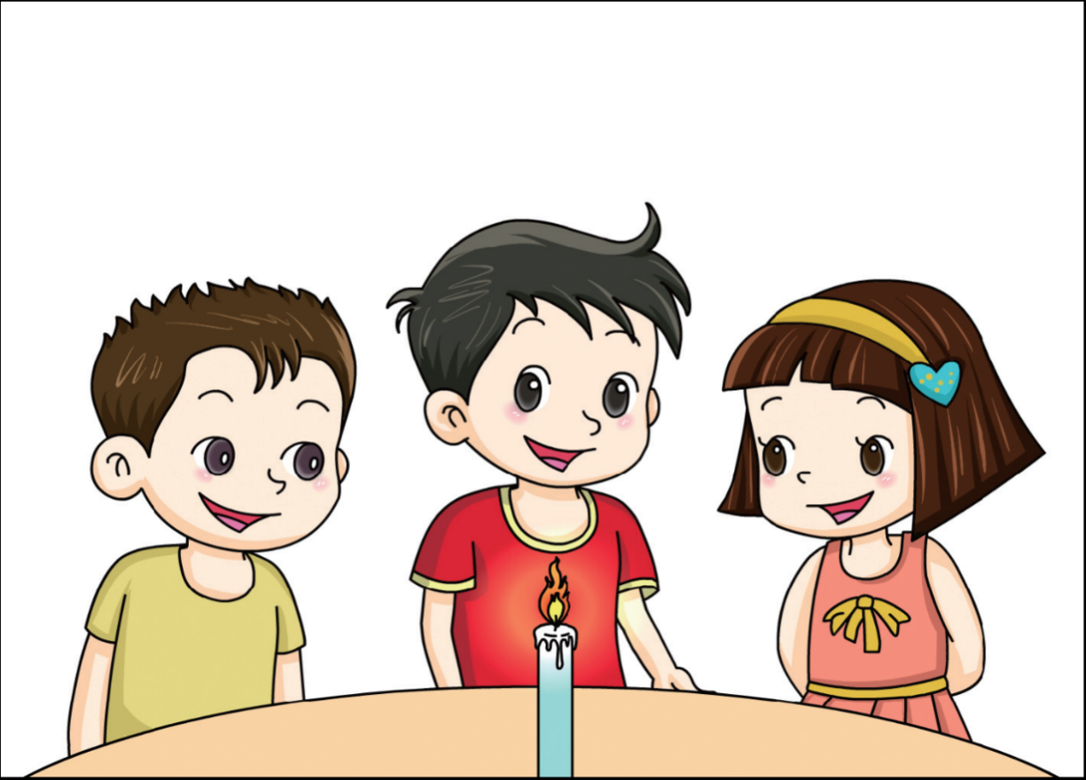
Observe
I can see the flame. The flame has two colours.
I can hear the crackle.
I can smell
burning.
When you study something closely, you are observing. You can look at it, listen to it, touch it, smell it or taste it.

Slide 2
Measure
12 cm
A ruler is a measuring instrument. When you use a measuring instrument, you are measuring. A measurement always has a number and a unit.

Slide 3
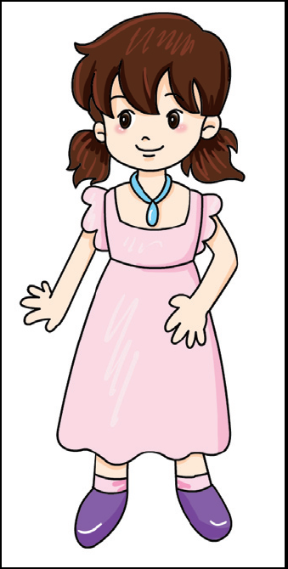
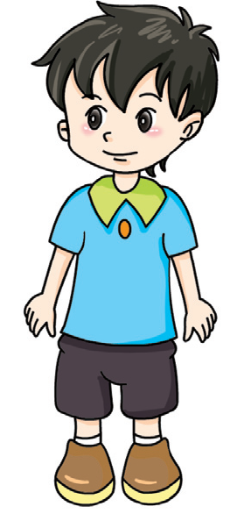
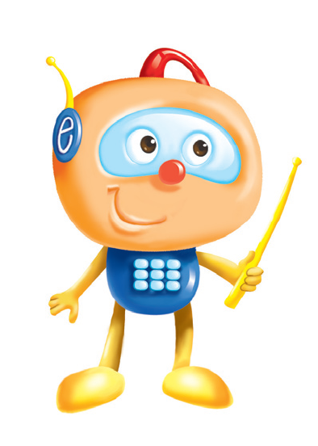
Compare
Who is taller?
If you have two or more objects, you can compare them.

Slide 4
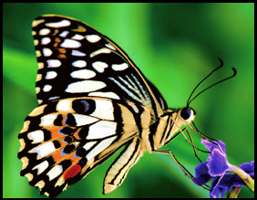
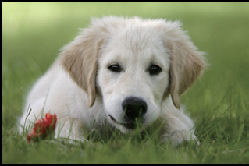
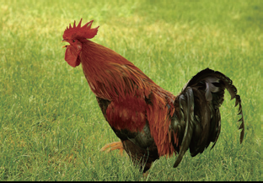
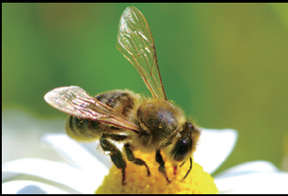
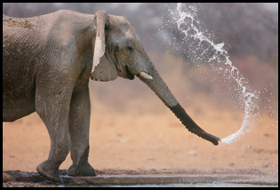
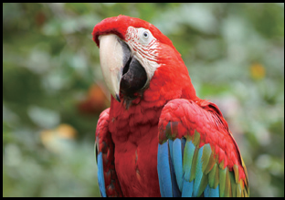
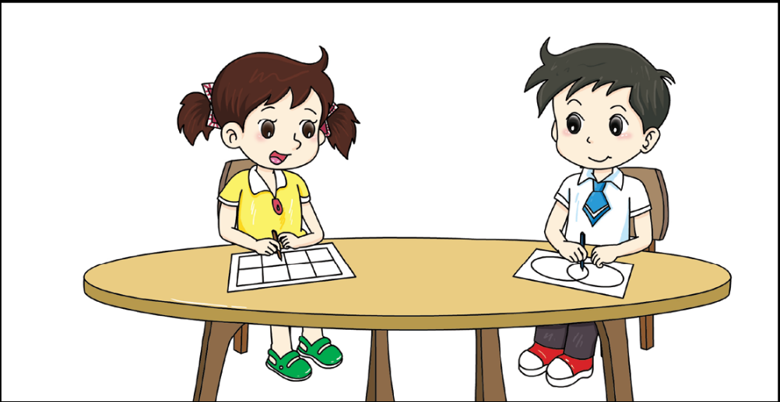
Classify
I want to group these animals by the number of their legs .
I want to group these animals by how they move.
When you put things into groups by certain features, you are classifying.

Slide 5
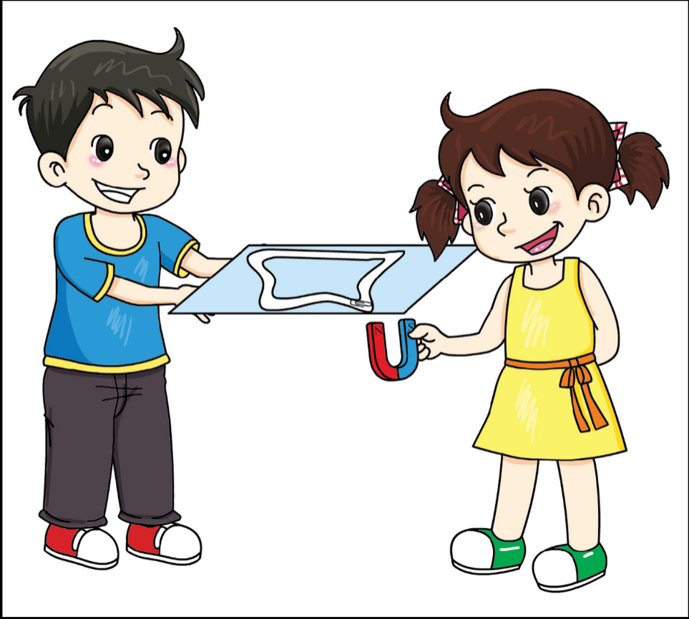
Experiment
Observe something. Think about your results. Did you learn something about science? You are experimenting.

Slide 6
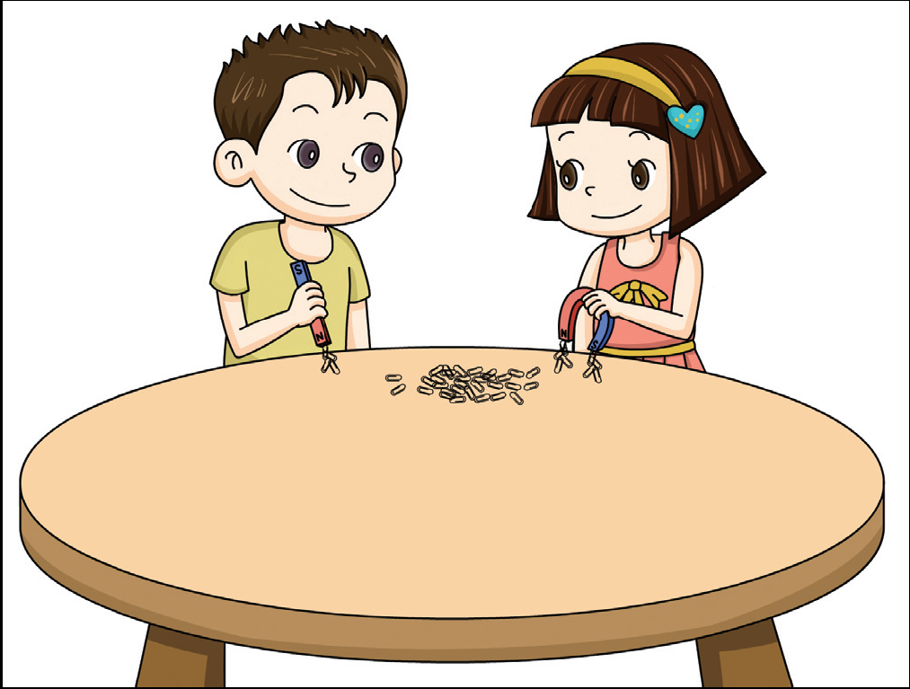
Fair test
We have to keep the same distance between the magnet and the paperclips.
We have to use paperclips of the same size .
If you want to compare results, you should do a fair test. How do you make a fair test? Change only one condition. Keep the other conditions the same.

